Slide 1
Micron OPAL VE3
Internal Full Report
Application Team
April 2025

Slide 2
Background

Slide 3
Project Background
Concentrate 30K fluoride and sulphate rich feed to 218K using membrane processes.
→ Difficulty in reaching target reject TDS due to Kogarkoite (Na3(SO4)F) precipitation.
Parameters | Units | ROI-2 Feed (RO Feed) | ROI-2 Reject (Target CFRO Reject)
pH | - | 7.5 | 8.1
K | ppm | 6 | 39
Na | ppm | 11168 | 77751
Ca | ppm | 10 | 66
Mg | ppm | 113 | 761
Cl | ppm | 8733 | 58371
SO4 | ppm | 9036 | 66619
PO4 | ppm | 1 | 3
HCO3 | ppm | 701 | 4505
F | ppm | 1053 | 7169
NO3 | ppm | 320 | 2115
CO3 | ppm | 2 | 39
CO2 | ppm | 36 | 59
SiO2 | ppm | 10 | 66
TMAH | ppm | 13 | 83
NH3 / NH4 | ppm | 153 | 1007
IPA | ppm | 42 | 245
TDS | ppm | 31295 | 218447
TSS | ppm | 1 | 0
COD | ppm | 128 | 761
Alkalinity | ppm | 576 | 3736

Slide 4
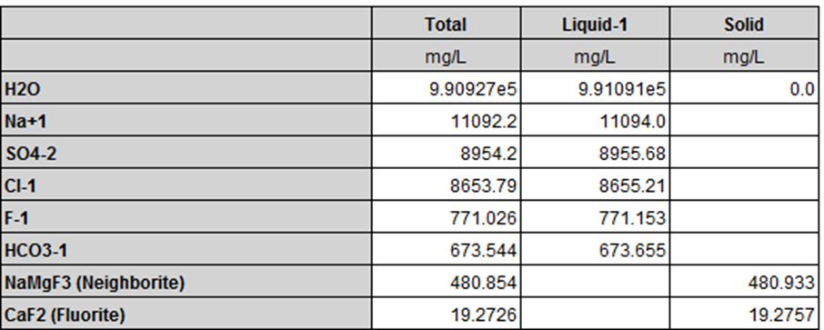
OLi Projection for ROi Feed
NaMgF3 and CaF precipitates are formed in the feed water.
Prepare synthetic feed to verify this projection.

Slide 5
Test Method: Synthetic Feed Preparation
Weight the salts required for synthetic feed according to the table below.
Prepare the synthetic feed according to the table below:
Collect samples of both bulk and NaF solutions and send for ICP and IC analysis.
Salts | Mass of Salts required For 1L (mg) | Volume to Prepare (L) | Mass of Salts required For 0.5L (mg)
Sodium Bicarbonate (NaHCO3) | 964.88 | 0.5 | 482.44
Sodium Fluoride (NaF) | 2326.73 | 0.5 | 1163.37
Sodium Sulphate (Na2SO4) | 13361.4 | 0.5 | 6680.70
Sodium Chloride (NaCl) | 13822.92 | 0.5 | 6911.46
Mgnesium Chloride (MgCl2) | 443.14 | 0.5 | 221.57
Calcium Chloride (CaCl) | 27.69 | 0.5 | 13.85
Solution |  | Bulk | NaF
Volume of DI Water | mL | 300 | 200
Salts Added | - | 1. NaHCO3 | 1. NaF
 |  | 2. Na2SO4
 |  | 3. NaCl
 |  | 4. MgCl2

Slide 6
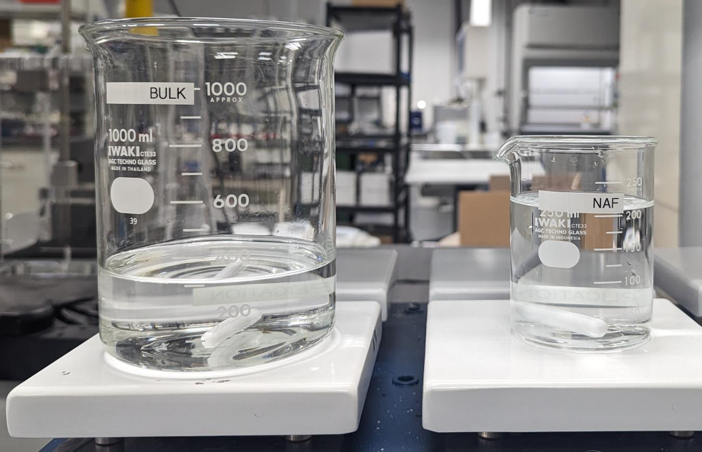
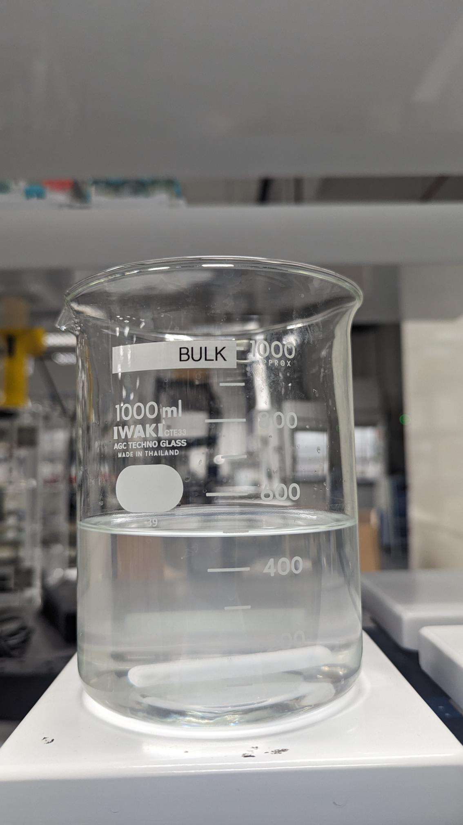
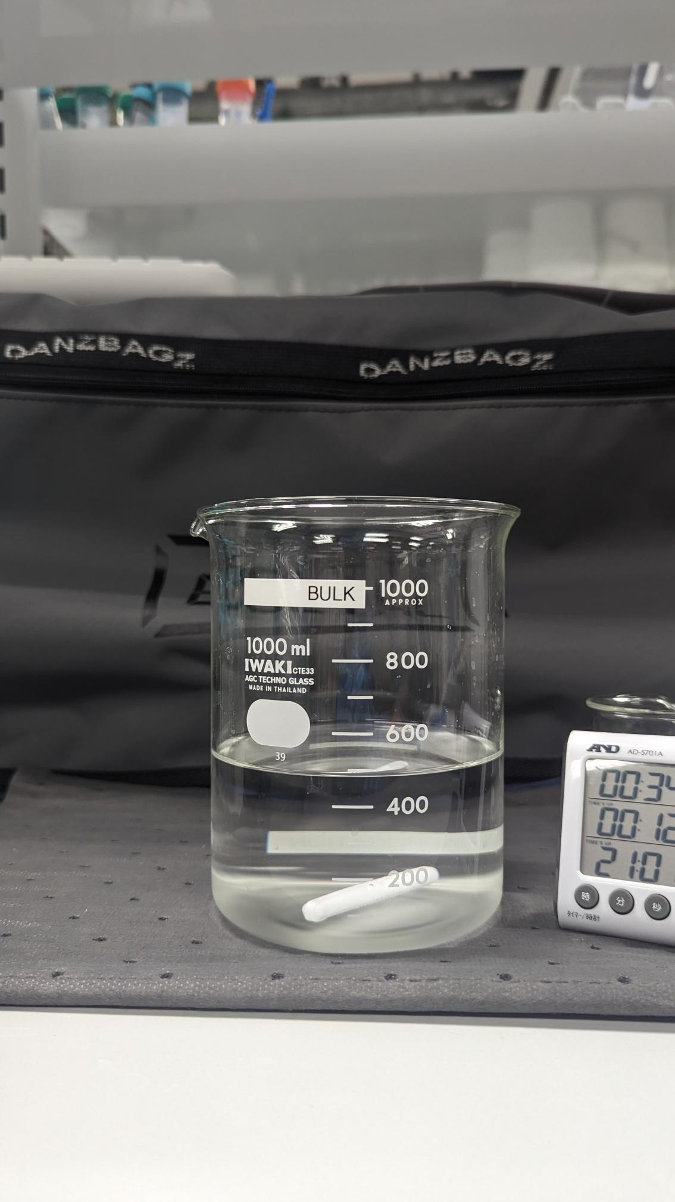
Observations
Bulk and NaF Solutions
Before Mixing
After Mixing
After Settling
All salts fully dissolved to give clear bulk and NaF solutions.
After mixing, the solution turned cloudy indicating precipitation.

Slide 7
Water Analysis Results
Parameters | Units | ROI-2 Feed | Synthetic ROI Feed Before Mixing | Synthetic ROI Feed After Mixing | Percentage decrease in [Ion] (%)
pH | - | 7.5 | 8.53 | - | -
Na | ppm | 11168 | 10544 | 11850 | -
Ca | ppm | 10 | < 10 | < 1 | ~ 90
Mg | ppm | 113 | 64 | 2 | 98
Cl | ppm | 8733 | 7623 | 8264 | -
SO4 | ppm | 9036 | 8796 | 9262 | -
F | ppm | 1053 | 1163 | 866 | 26
TDS | ppm | 31295 | 28190 | 30244 | -
[Mg 2+] decreases by up to 98%, [Ca 2+] decreases by ~90% and [F -] decreases by 26%.

Slide 8
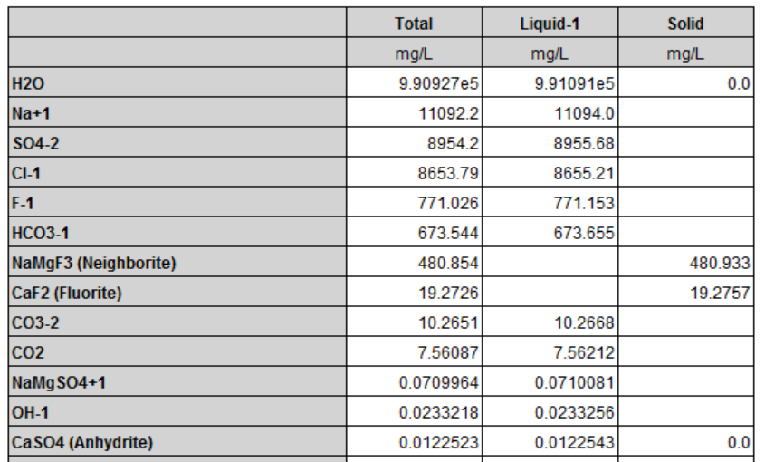
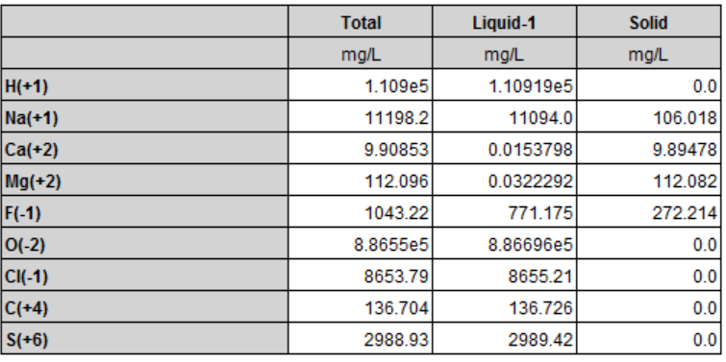
OLi Projection for RO Feed
Projected Precipitation
Projected Ion Concentration
OLi projected precipitation verified.
Prepare ROI Synthetic feed without Mg and Ca dosage and decrease the initial [F -] by 26% according to OLi projection for RO trial.

Slide 9
Conclusions
Precipitation was observed in the synthetic ROI Feed prepared.
[Mg 2+] decreases by up to 98%, [Ca 2+] decreases by ~90% and [F -] decreases by 26%.
Prepare ROI Synthetic feed without Mg and Ca dosage and decrease the initial [F -] by 26% for RO trial.

Slide 10
Plan 1: RO + CFRO (M150+M250)

Slide 11
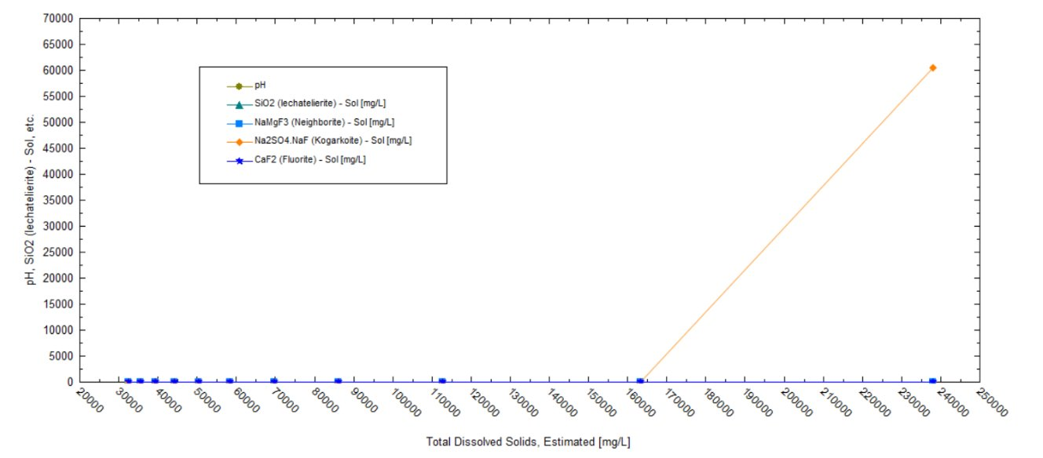
OLi Projections: Precipitation against TDS
Kogarkoite precipitation when TDS > 160K mg/L.

Slide 12
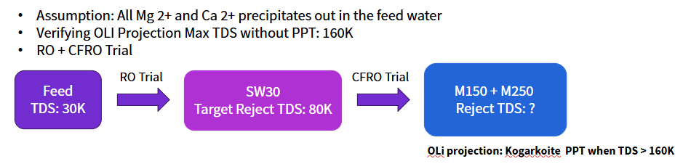
Objectives
To investigate the feasibility of treating VE3 feed with membrane processes.
Prepare 30K ROI feed for RO trial.
Prepare 80K synthetic RO reject for CFRO trial.

Slide 13
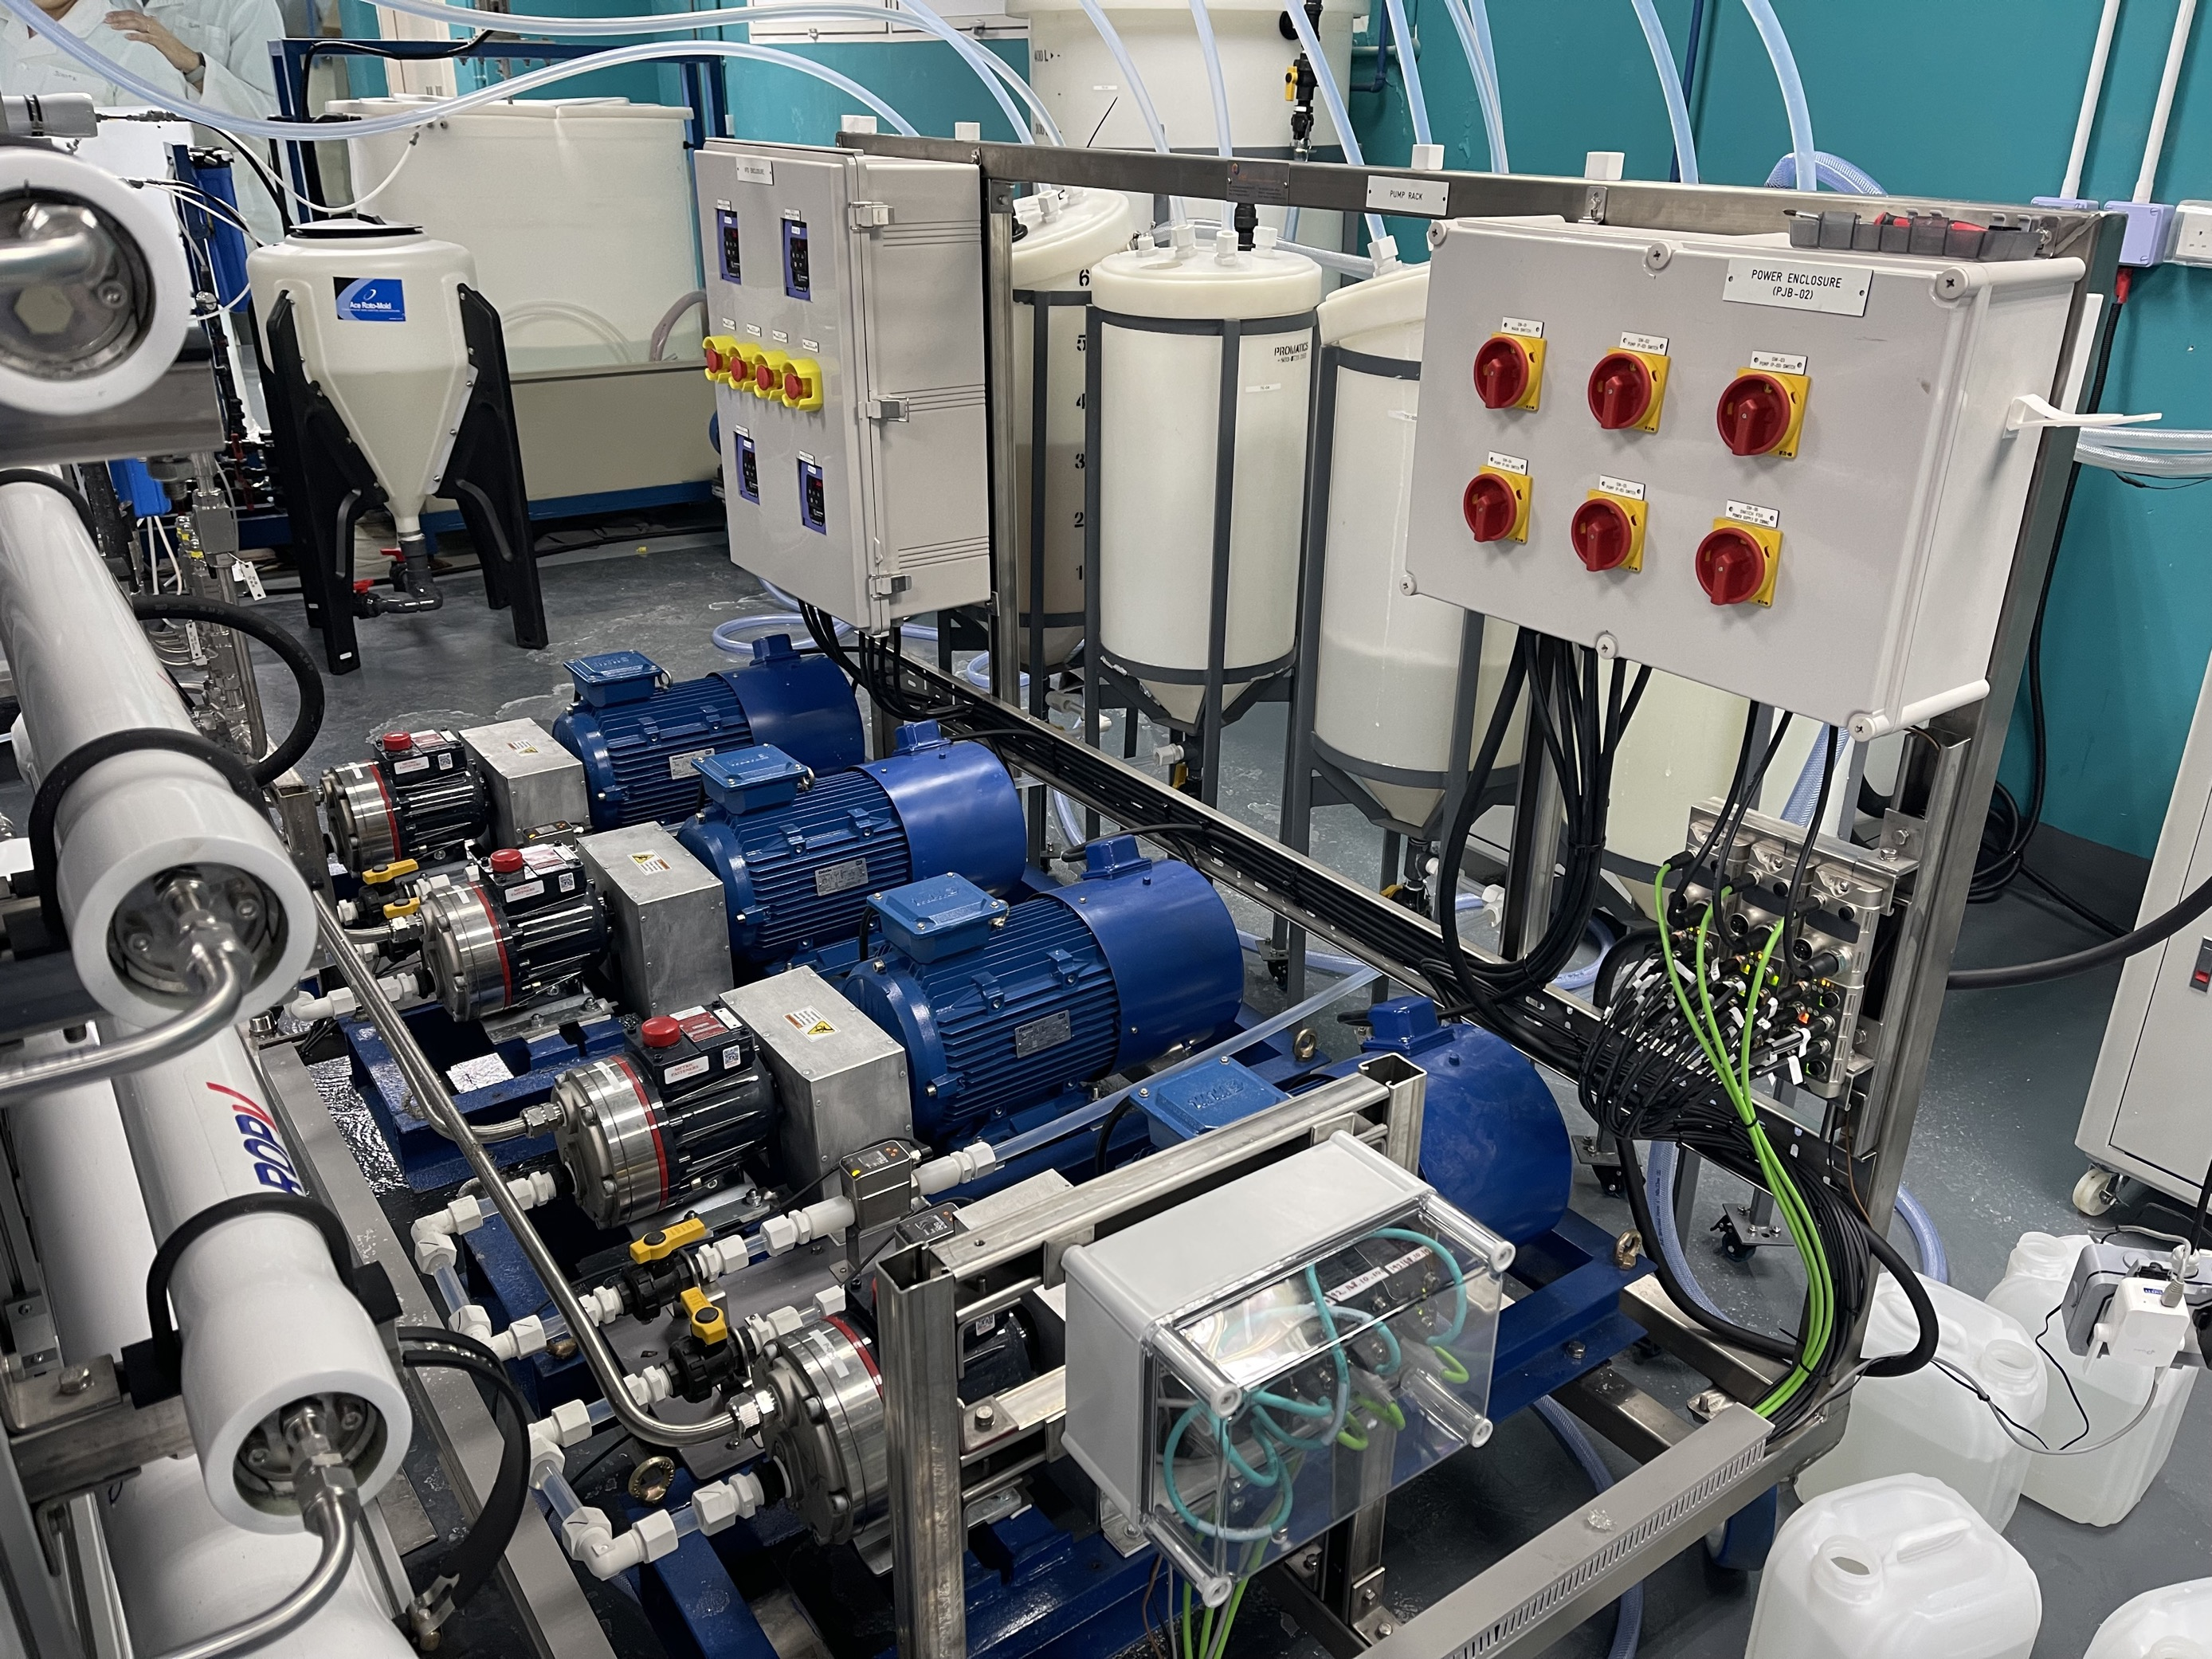
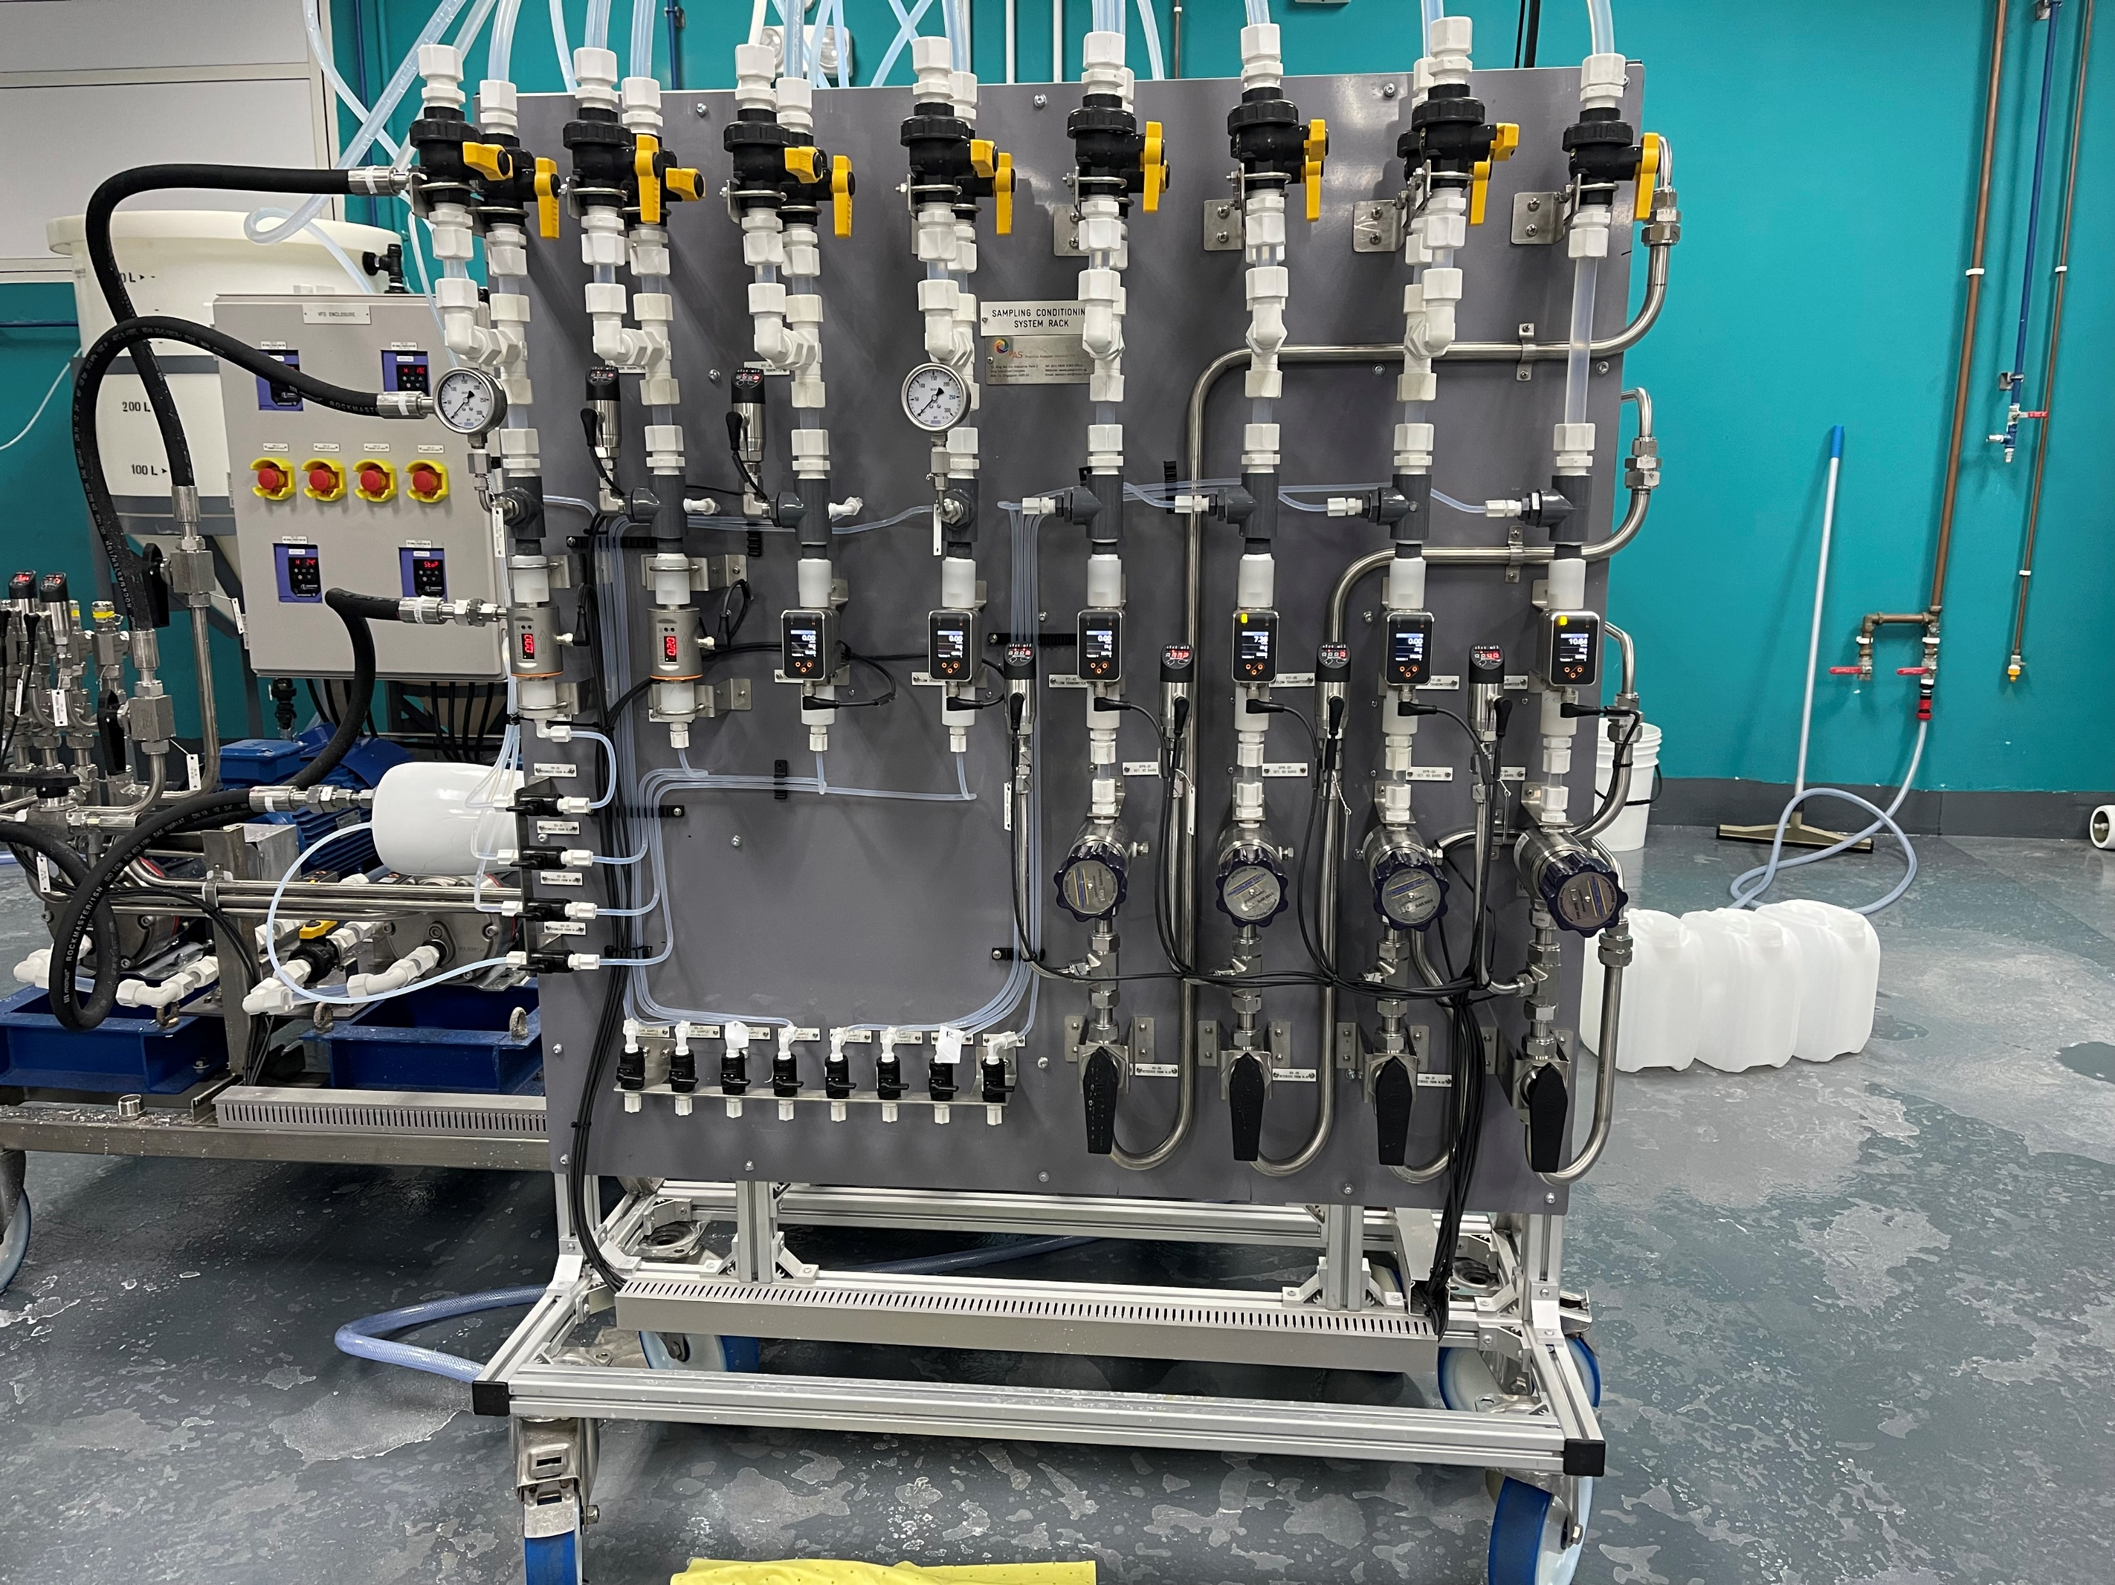
Lab skid

Slide 14
Test Method
Prepare Synthetic ROI Feed – 60L
Perform pretreatment testing
Perform ROI concentration testing
Generate tap water permeate using SWRO membrane to minimize [Ca 2+]
Prepare synthetic feed based on the feed water quality report using tap water permeate
Perform water analysis on the synthetic ROI feed
Perform antiscalant projections to determine necessity of pretreatment, antiscalant type, and dosage
No antiscalant dosage required as SWRO tap water permeate is used in synthetic feed preparation
Load SWRO membrane into pressure vessel
Start the pumps to circulate the feed water into the system with reject returned into feed tank while permeate is collected separately
Record flow rates, pressures & refractive index (conversion to TDS by calibration curve) at regular intervals
Stop current ROI stage testing when flux has reached minimum threshold
Collect samples of feed, permeate & reject for water analysis
Prepare synthetic feed for CFRO run using the RO reject water analysis report
Load CFRO membrane & operate as the next stage as needed

Slide 16
RO Trial Feed Water Analysis
PARAMETER | METHOD | UNIT | ROI-2 Feed (Projection) | Synthetic ROI Feed
pH | pH probe | - | 7.50 | 8.24
Conductivity | Conductivity probe | µS/cm | - | 38400
Hydroxide, OH Alkalinity | APHA 2320B | CaCO₃ mg/l | - | <2
Carbonate Alkalinity, CO3/ P-Alkalinity | APHA 2320B | CaCO₃ mg/l | - | <2
Bicarbonate Alkalinity, HCO3/ M-Alkalinity | APHA 2320B | CaCO₃ mg/l | 576 | 609
Total Alkalinity | APHA 2320B | CaCO₃ mg/l | 576 | 609
Fluoride as F | Ion Chromatography | mg/l | 778 | 785
Chloride as Cl | Ion Chromatography | mg/l | 8733 | 8831
Sulphate as SO₄ | Ion Chromatography | mg/l | 9036 | 8695
Nitrate as NO₃ | Ion Chromatography | mg/l | 320 | 270
Ammonia as NH₃ | Hach 10031 | mg/l | 153 | 186
Calcium as Ca | EPA200.7 | mg/l | 0 | <1
Magnesium as Mg | EPA200.7 | mg/l | 0 | <1
Potassium as K | EPA200.7 | mg/l | 6 | <1
Silica SiO2 | EPA200.7/ Calculation | mg/l | 10 | 7.21
Sodium as Na | EPA200.7 | mg/l | 11168 | 10910
Total Hardness as CaCO3 | APHA 2340B | mg/l | 0 | <1
TDS | APHA 2540C | mg/l | 31295 | 25700
TDS | Ultrameter (NaCl) | mg/l | - | 28320
Turbidity | APHA 2130B | NTU | - | 0.25
TSS | Photometric | mg/l | 1 | <3
PARAMETER | METHOD | UNIT | ROI-2 Feed (Projection) | Synthetic ROI Feed
Total Chlorine | Hach 8021 | mg/l | - | 0.03
Free Chlorine | Hach 8021 | mg/l | - | 0.04
Total Ions | Calculation | mg/l | 31055 | 30293
TDS & Total Ions Difference (by Gravimetry) | Calculation | % | -0.77 | 15.2
TDS & Total Ions Difference (by Ultrameter) | Calculation | % | - | 6.51
Salts | Feed Volume (L) | Mass of salts required (g) | Actual Mass of salts used (g)
NH42SO4 | 60 | 33.7 | 33.7
NaHCO3 | 60 | 57.9 | 57.9
NaF | 60 | 103 | 103
NaNO3 | 60 | 26.4 | 26.4
Na2SO4 | 60 | 765 | 765
NaCl | 60 | 864 | 864
Na2SiO3 | 60 | 1.12 | 1.12

Slide 17
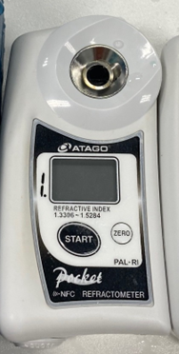
Interim TDS measurements via ATAGO RI meter
The Atago PAL-03S refractometer is used to measure the refractive index of the brine, given the non-linearity between TDS and conductivity that occurs at higher salinities and that the main components are NaCl and Na2SO4.

Slide 18
RO Concentration Results
The feed was concentrated from 25,700 mg/L to 95,200 mg/L TDS.
Recovery obtained from gravimetric measurement of TDS is 72.2%.
The final RO permeate TDS obtained is 132 mg/L.
Operating parameters:
Feed pressure: 800-1000 psi (55-69 bar)
Flow rate: 10 - 11 LPM
Temperature: 25̊ C
Membrane: Dupont FilmTec SW30-2540

Slide 19
RO Trial Water analysis Results
PARAMETER | METHOD | UNIT | Synthetic ROI Feed | RO Reject | RO Permeate
pH | pH probe | - | 8.24 | 8.32 | 10.1
Conductivity | Conductivity probe | µS/cm | 38400 | 100300 | 340
Hydroxide, OH Alkalinity | APHA 2320B | CaCO₃ mg/l | <2 | <2 | <2
Carbonate Alkalinity, CO3/ P-Alkalinity | APHA 2320B | CaCO₃ mg/l | <2 | <2 | 66
Bicarbonate Alkalinity, HCO3/ M-Alkalinity | APHA 2320B | CaCO₃ mg/l | 609 | 1864 | 3
Total Alkalinity | APHA 2320B | CaCO₃ mg/l | 609 | 1864 | 69
Fluoride as F | Ion Chromatography | mg/l | 785 | 2584 | 2.21
Chloride as Cl | Ion Chromatography | mg/l | 8831 | 28698 | <0.1
Sulphate as SO₄ | Ion Chromatography | mg/l | 8695 | 30286 | 9.93
Nitrate as NO₃ | Ion Chromatography | mg/l | 270 | 929 | 4.22
Ammonia as NH₃ | Hach 10031 | mg/l | 186 | 396 | 12.9
Calcium as Ca | EPA200.7 | mg/l | <1 | <1 | <1
Magnesium as Mg | EPA200.7 | mg/l | <1 | <1 | <1
Silica SiO2 | EPA200.7/ Calculation | mg/l | 7.21 | 39.5 | <0.1
Sodium as Na | EPA200.7 | mg/l | 10910 | 37300 | 68.7
Total Hardness as CaCO3 | APHA 2340B | mg/l | <1 | <1 | <1
TDS | APHA 2540C | mg/l | 25700 | 95200 | 132
TDS | Ultrameter (NaCl) | mg/l | 28320 | 74140 | 482
Turbidity | APHA 2130B | NTU | 0.250 | 0.624 | 0.174
TSS | Photometric | mg/l | <3 | <3 | <3
PARAMETER | METHOD | UNIT | Synthetic ROI Feed | RO Reject | RO Permeate
Total Chlorine | Hach 8021 | mg/l | 0.03 | 0.1 | <0.02
Free Chlorine | Hach 8021 | mg/l | 0.04 | 0.1 | <0.02
Total Ions | Calculation | mg/l | 30293 | 102097 | 167
TDS & Total Ions Difference (by Gravimetry) | Calculation | % | 15.2 | 6.76 | 20.9
TDS & Total Ions Difference (by Ultrameter) | Calculation | % | 6.51 | 27.38 | -189

Slide 20
Fluoride and Sulphate Rejection
Parameters | Units | RO Reject | RO Permeate | Rejection (%)
Sulphate as SO₄ | mg/L | 30286 | 9.93 | 99.96
Fluoride as F | mg/L | 2584 | 2.21 | 99.91
F – and SO4 2- rejection are within expected range (~99%).

Slide 21
RO Flux against Feed TDS Graph
Recommended Final RO Reject TDS: ~ 75K mg/L when flux ~ 5 LMH.

Slide 22
RO Rejection against Feed TDS Graph

Slide 23
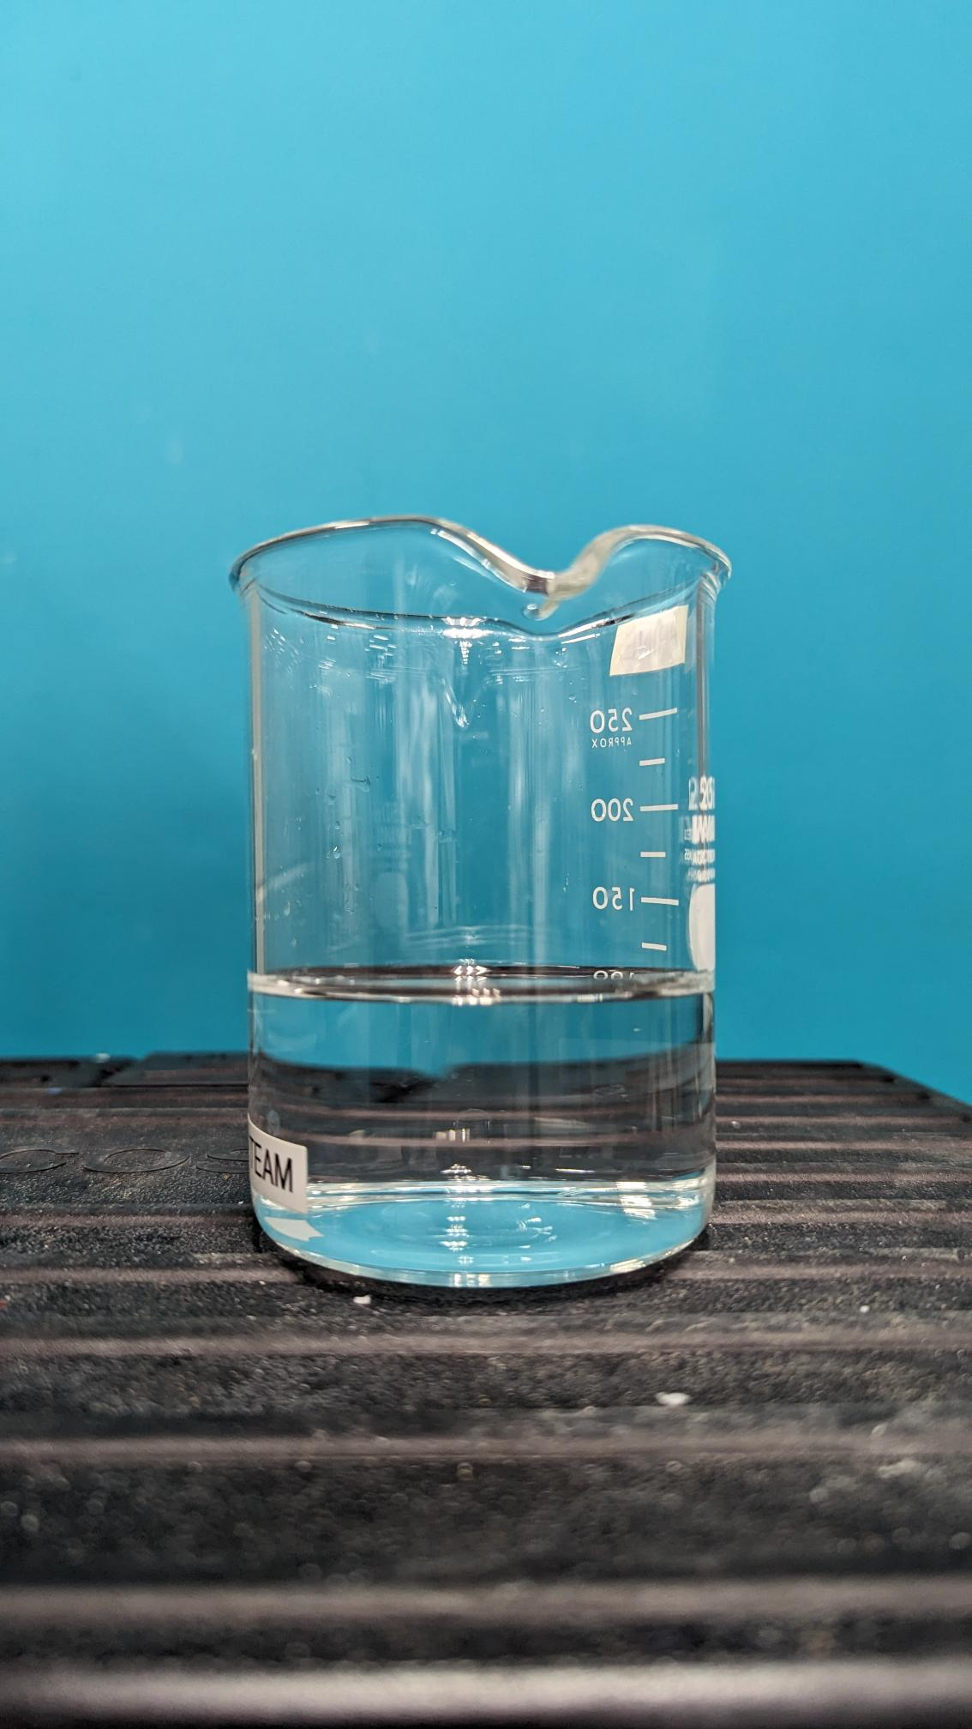
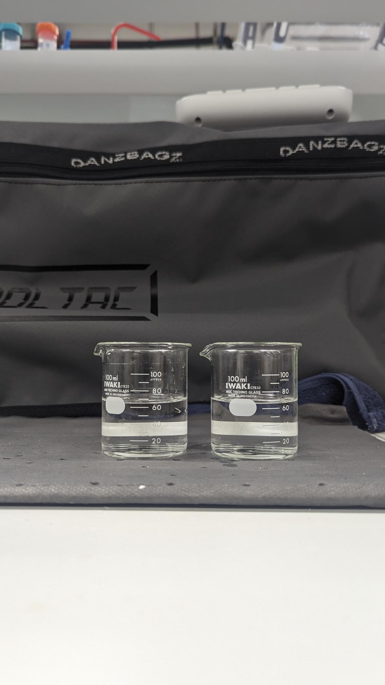
Sample Photos
Feed Water
Reject
Permeate
Feed, reject and permeate are clear solution.

Slide 24
RO Trial Conclusions
The feed was concentrated from 25,700 mg/L to 95,200 mg/L TDS.
Recovery obtained from gravimetric measurement of TDS is 72.2%.
The final RO permeate TDS obtained is 132 mg/L.
F – and SO4 2- rejection is within expected range (~99%).
Recommended Final RO Reject TDS: ~ 75K mg/L when flux ~ 5 LMH.
Prepare synthetic RO reject for CFRO trial.

Slide 26
CFRO Trial Feed Water Analysis
PARAMETER | METHOD | UNIT | RO Reject | Synthetic CFRO Feed
pH | pH probe | - | 8.32 | 8.06
Conductivity | Conductivity probe | µS/cm | 100300 | 93500
Hydroxide, OH Alkalinity | APHA 2320B | CaCO₃ mg/l | <2 | <2
Carbonate Alkalinity, CO3/ P-Alkalinity | APHA 2320B | CaCO₃ mg/l | <2 | <2
Bicarbonate Alkalinity, HCO3/ M-Alkalinity | APHA 2320B | CaCO₃ mg/l | 1864 | 2094
Total Alkalinity | APHA 2320B | CaCO₃ mg/l | 1864 | 2094
Fluoride as F | Ion Chromatography | mg/l | 2584 | 2669
Chloride as Cl | Ion Chromatography | mg/l | 28698 | 24593
Sulphate as SO₄ | Ion Chromatography | mg/l | 30286 | 28073
Nitrate as NO₃ | Ion Chromatography | mg/l | 929 | 864
Ammonia as NH₃ | Hach 10031 | mg/l | 396 | 261
Calcium as Ca | EPA200.7 | mg/l | <1 | <1
Magnesium as Mg | EPA200.7 | mg/l | <1 | <1
Silica SiO2 | EPA200.7/ Calculation | mg/l | 39.5 | 26.1
Sodium as Na | EPA200.7 | mg/l | 37300 | 37700
Total Hardness as CaCO3 | APHA 2340B | mg/l | <1 | <1
TDS | APHA 2540C | mg/l | 95200 | 92510
TDS | Ultrameter (NaCl) | mg/l | 74140 | 68220
Turbidity | APHA 2130B | NTU | 0.624 | 0.122
TSS | Photometric | mg/l | <3 | 5
TSS | APHA 2540D | mg/l | - | -
Total Chlorine | Hach 8021 | mg/l | 0.1 | <2
PARAMETER | METHOD | UNIT | RO Reject | Synthetic CFRO Feed
Free Chlorine | Hach 8021 | mg/l | 0.1 | <0.2
Total Ions | Calculation | mg/l | 102097 | 96019
TDS & Total Ions Difference (by Gravimetry) | Calculation | % | 6.76 | 3.92
TDS & Total Ions Difference (by Ultrameter) | Calculation | % | 27.4 | 29.1
Salts | Feed Volume (L)​ | Mass of salts required (g)​ | Actual Mass of salts used (g)​
NH42SO4​ | 400​ | 484​ | 484​
NaHCO3​ | 400​ | 1404​ | 1404
NaF​ | 400​ | 2236​ | 2236​
NaNO3​ | 400​ | 544​ | 545​
Na2SO4​ | 400​ | 17296​ | 20496​
NaCl​ | 400​ | 18576​ | 18576​
Na2SiO3​ | 400​ | 28​ | 28​

Slide 27
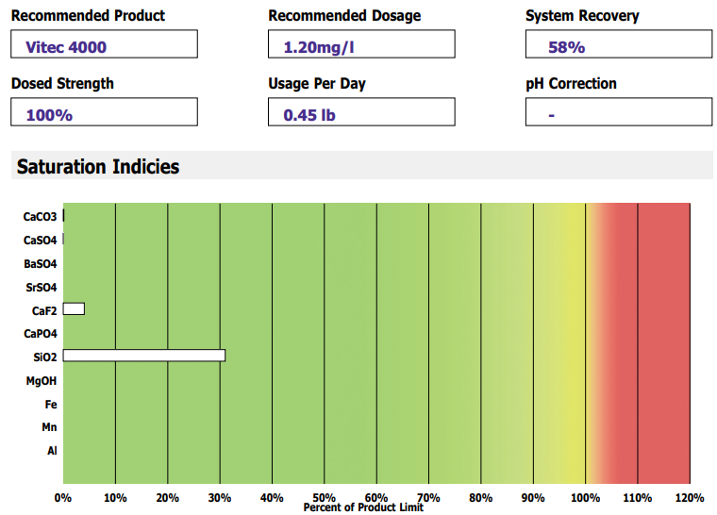
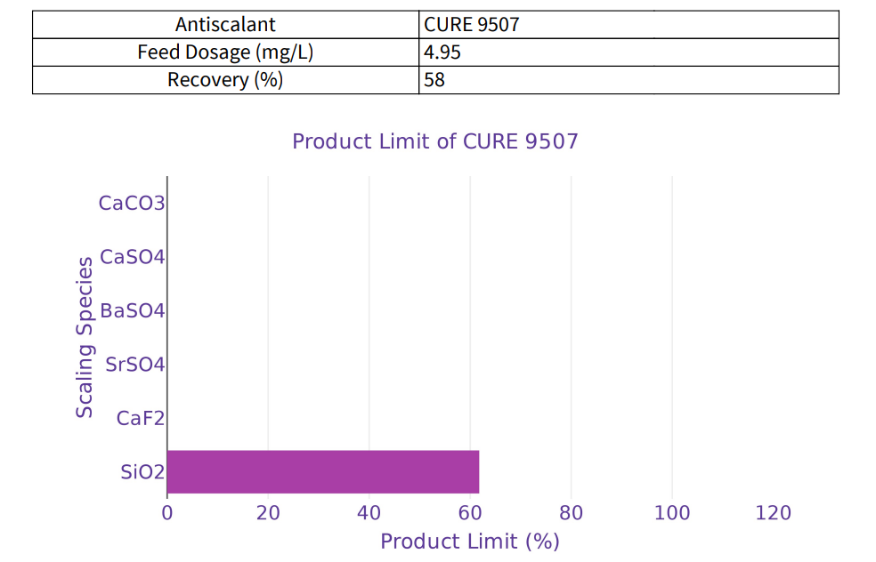
Anti-scalant Projection
Target recovery: 58%
Projected Reject TDS: 238,555 mg/L
Antiscalant: Vitec4000 (CURE9507) @ 1.20ppm every 2 hours

Slide 28
CFRO Concentration Results
The feed was concentrated from 92,510 mg/L to 180,410 mg/L TDS.
Recovery obtained from gravimetric measurement of TDS is 48.7%.
The final CFRO permeate TDS obtained is 60,622 mg/L.
Operating parameters:
Feed pressure: 800 psi (55 bar)
*M150-2540 has a lower pressure rating than M150-4040.
Flow rate: 10 - 11 LPM
Temperature: 25̊ C
Membrane: M150-2540

Slide 29
CFRO M150 Trial Water analysis Results
PARAMETER | METHOD | UNIT | Synthetic CFRO Feed | M150 Reject | M150 Permeate
pH | pH probe | - | 8.06 | 8.16 | 8.34
Conductivity | Conductivity probe | µS/cm | 93500 | 129900 | 84600
Hydroxide, OH Alkalinity | APHA 2320B | CaCO₃ mg/l | <2 | <2 | <2
Carbonate Alkalinity, CO3/ P-Alkalinity | APHA 2320B | CaCO₃ mg/l | <2 | <2 | <2
Bicarbonate Alkalinity, HCO3/ M-Alkalinity | APHA 2320B | CaCO₃ mg/l | 2094 | 4423 | 1630
Total Alkalinity | APHA 2320B | CaCO₃ mg/l | 2094 | 4432 | 1630
Fluoride as F | Ion Chromatography | mg/l | 2584 | 5190 | 2099
Chloride as Cl | Ion Chromatography | mg/l | 28698 | 32781 | 31751
Sulphate as SO₄ | Ion Chromatography | mg/l | 30286 | 74842 | 1457
Nitrate as NO₃ | Ion Chromatography | mg/l | 929 | 474 | 822
Ammonia as NH₃ | Hach 10031 | mg/l | 396 | 487 | 192
Calcium as Ca | EPA200.7 | mg/l | <1 | <1 | <1
Magnesium as Mg | EPA200.7 | mg/l | <1 | <1 | <1
Silica SiO2 | EPA200.7/ Calculation | mg/l | 26.1 | 63.0 | 23.2
Sodium as Na | EPA200.7 | mg/l | 37700 | 70000 | 24370
Total Hardness as CaCO3 | APHA 2340B | mg/l | <1 | <1 | <1
TDS | APHA 2540C | mg/l | 92510 | 180410 | 60622
TDS | Ultrameter (NaCl) | mg/l | 68220 | 100300 | 59540
Turbidity | APHA 2130B | NTU | 0.122 | 0.884 | 0.076
TSS | Photometric | mg/l | 5 | 2 | 1
PARAMETER | METHOD | UNIT | Synthetic CFRO Feed | M150 Reject | M150 Permeate
Total Chlorine | Hach 8021 | mg/l | <2 | <2 | <2
Free Chlorine | Hach 8021 | mg/l | <0.2 | <0.2 | <0.2
Total Ions | Calculation | mg/l | 96280 | 187782 | 62152
TDS & Total Ions Difference (by Gravimetry) | Calculation | % | 3.92 | 4.17 | 2.76
TDS & Total Ions Difference (by Ultrameter) | Calculation | % | 29.1 | 46.7 | 4.50

Slide 30
Sulphate to Fluoride Ratio
Ions | Units | OLi Projection |  |  | 180K TDS Reject (M150 Experiment Values)
 |  | Target 218K TDS Reject | 160K TDS Reject | 210K TDS Reject
SO4 | ppm | 66619 | 49536 | 66619 | 74842
F | ppm | 7169 | 5331 | 2488 | 5190
Ratio | - | 9.29 | 9.29 | 26.8 | 14.4
No Kogarkoite precipitation

Slide 31
M150 Fluoride and Sulphate Rejection
Feed TDS (RI Converted) (mg/L) | 89637 | 100278 | 128022 | 141365 | 162091
Reject [F -] (mg/L) | 3002 | 3271 | 4146 | 4559 | 5190
Permeate [F -] (mg/L) | 375 | 533 | 1126 | 1413 | 2099
Fluoride Rejection (%) | 87.5 | 83.7 | 72.8 | 69.0 | 59.6
Reject [SO4 2-] (mg/L) | 32806 | 37963 | 51949 | 60482 | 74842
Permeate [SO4 2-] (mg/L) | 317 | 514 | 838 | 1078 | 1457
Sulphate Rejection (%) | 99.0 | 98.6 | 98.4 | 98.2 | 98.1
Fluoride rejection decreases to 59.6% as feed TDS increases.
Sulphate rejection ~98%.

Slide 32
CFRO Flux against Feed TDS Graph

Slide 33
CFRO Rejection against Feed TDS Graph

Slide 34
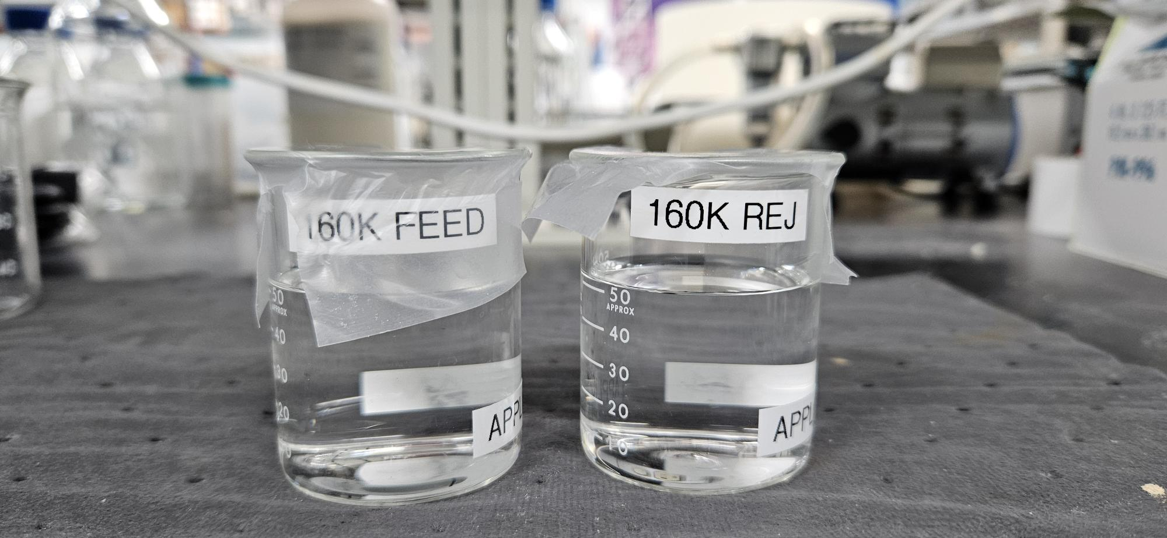
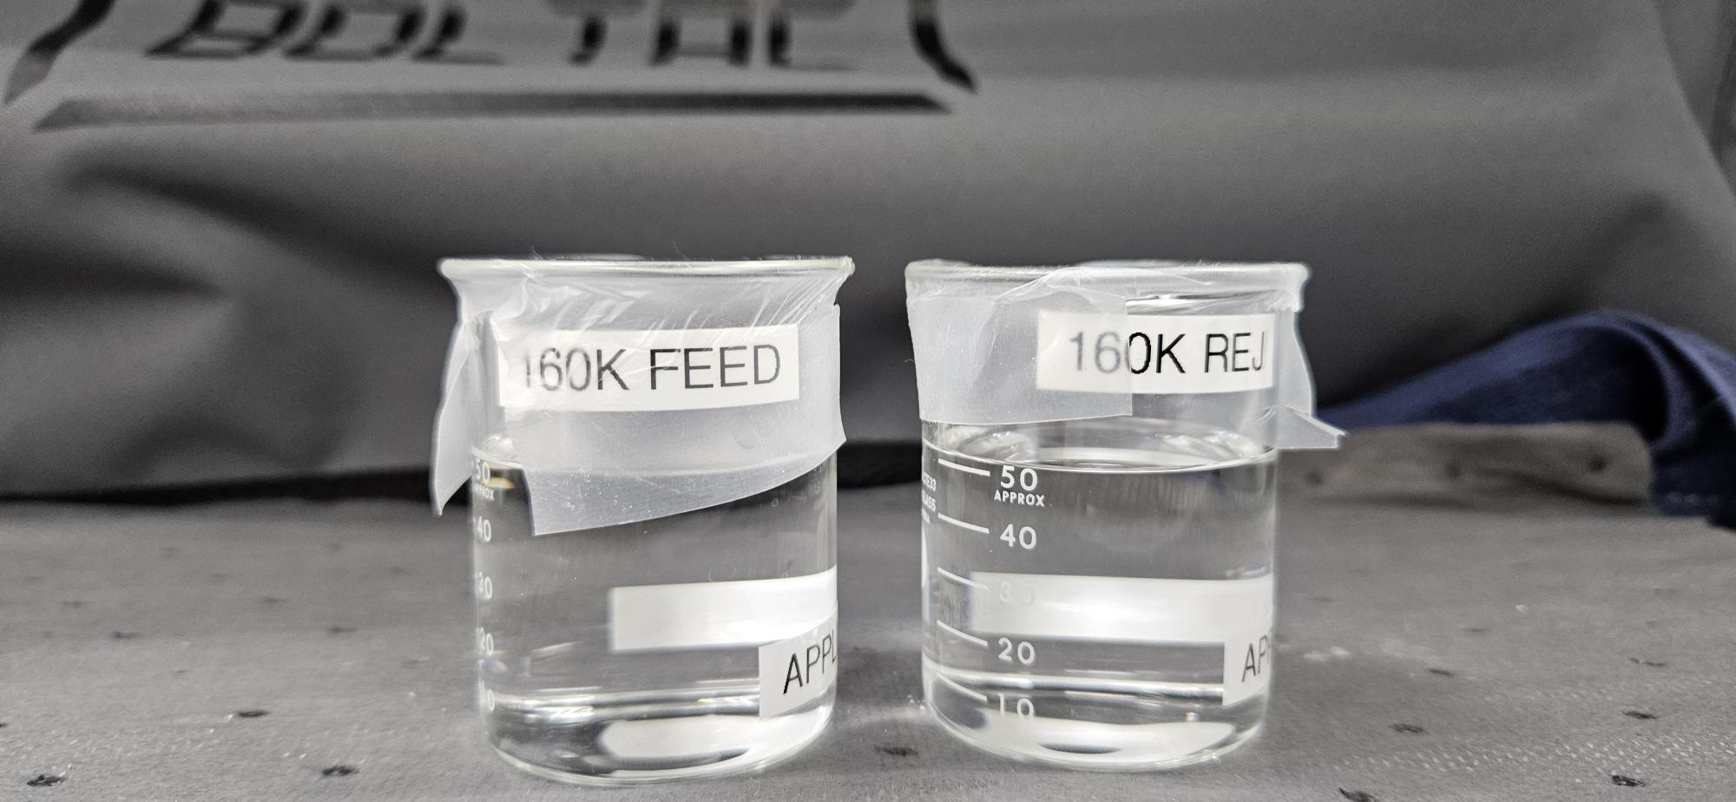
Sample Photos
After
24 hrs
Collected from
Feed Tank
Collected from
Reject Sampling Valve
Collected from
Feed Tank
Collected from
Reject Sampling Valve
No precipitation observed in the reject after one day.

Slide 35
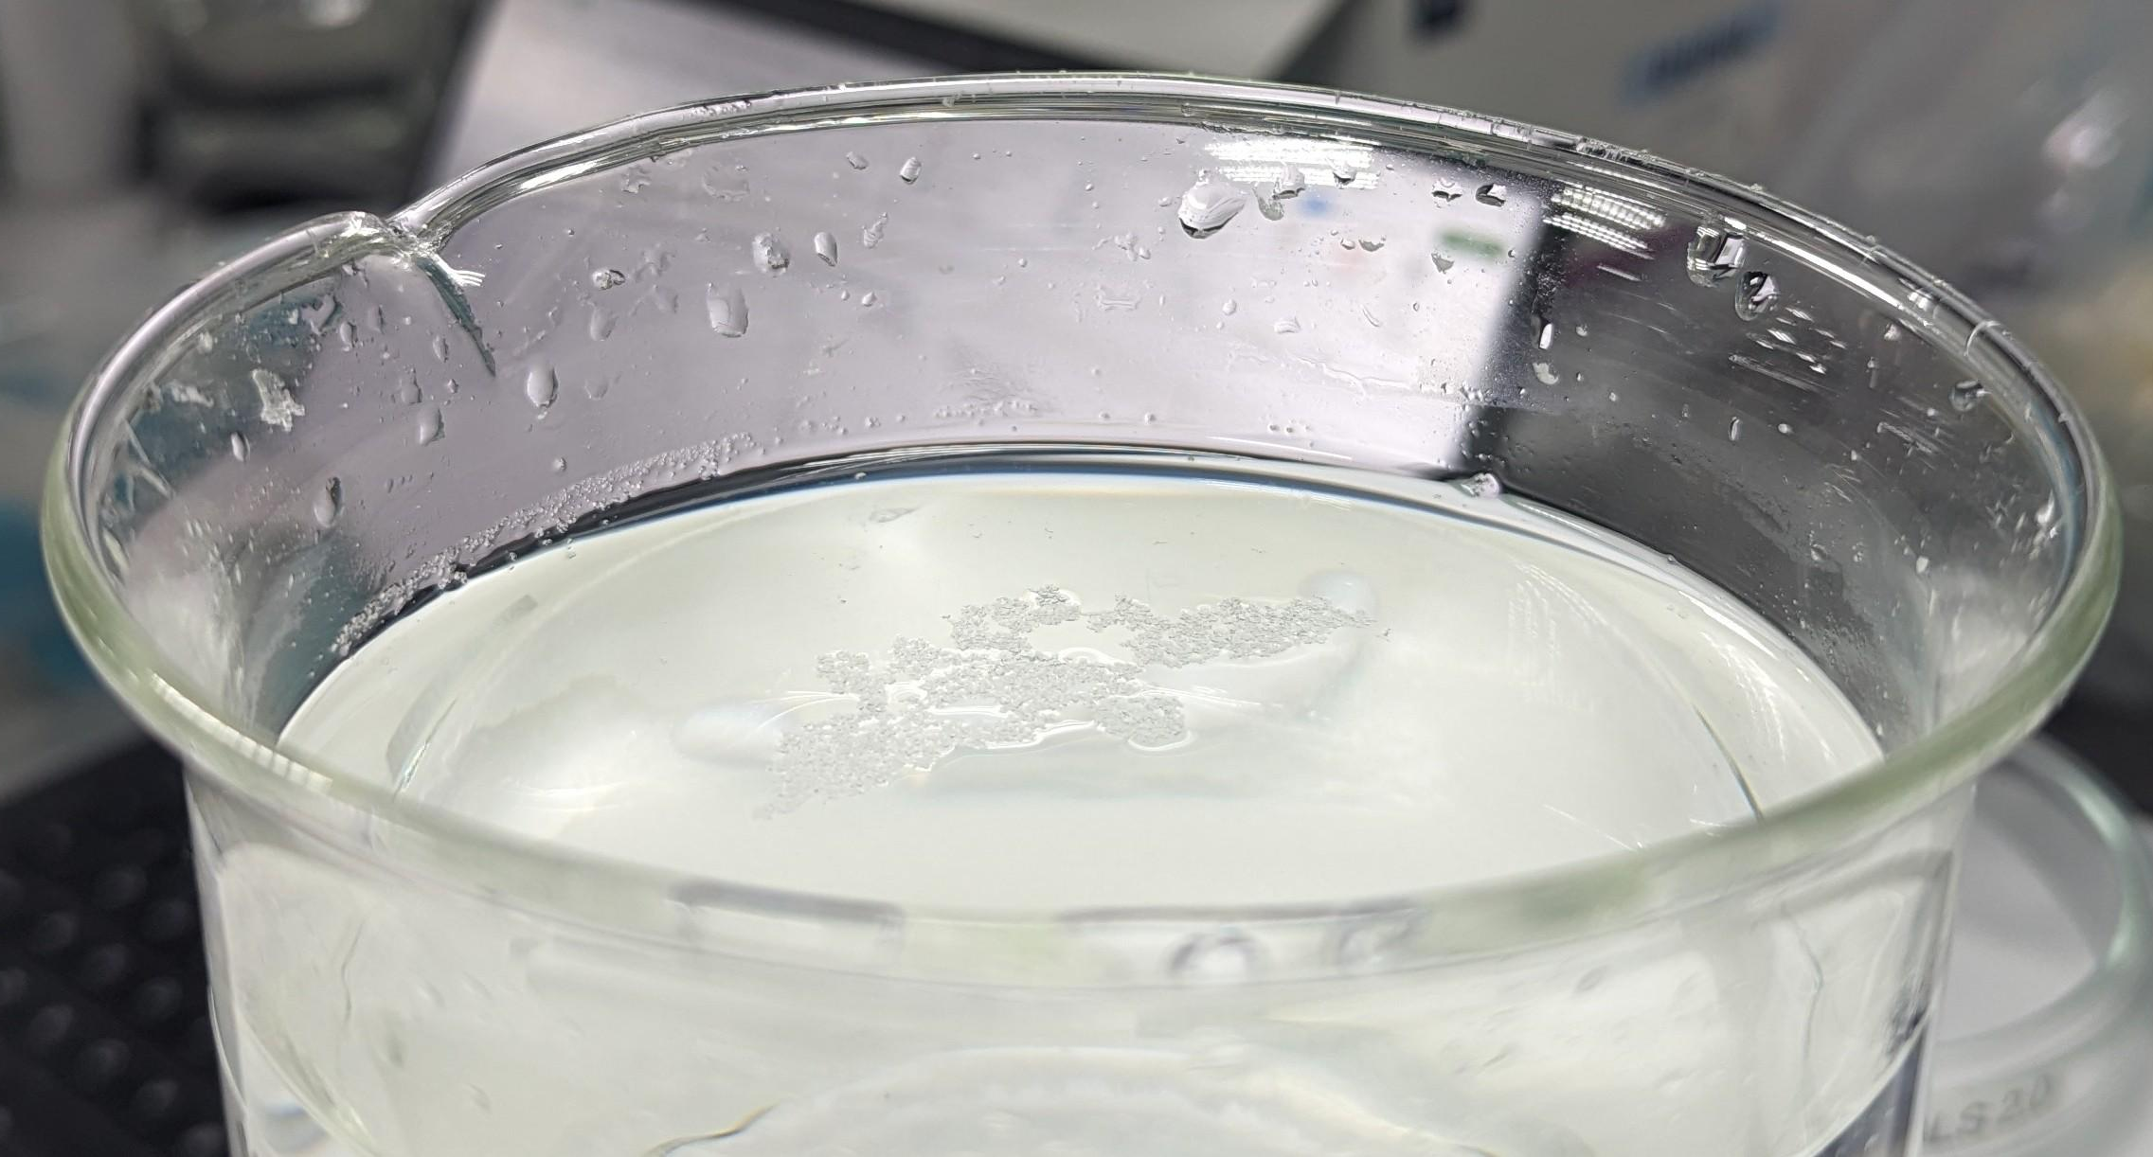
Sample Photos
Precipitation observed after one day when parafilm was removed for evaporation to occur.
180K reject was near saturation point.

Slide 36
CFRO Trial Conclusions
The feed was concentrated from 92,510 mg/L to 180,410 mg/L TDS.
Recovery obtained from gravimetric measurement of TDS is 48.3%.
The final CFRO permeate TDS obtained is 60,622 mg/L.
Fluoride rejection decreases to 59.6% as feed TDS increases.
Sulphate rejection ~98%.
No precipitation was observed in the reject after one day when sample was parafilmed.
Precipitation observed after one day when parafilm was removed for evaporation to occur, indicating that 180K reject is near saturation point.

Slide 37
Summary
Assumption: All Mg 2+ and Ca 2+ precipitates out in the feed water
Verifying OLI Projection Max TDS without PPT: 160K
RO + CFRO Trial
Feed
TDS: 25K
SW30-2540
Reject TDS: 95K (~56L)
Permeate TDS: 132
M150-2540
Reject TDS: 180K (~19L)
Permeate TDS: 60K (~37L)
Recovery from
Gravimetric Measurement: 72.2%
Recovery by
Gravimetric Measurement: 48.3%
Recovery by Volume:
66.1%
M150 reject near saturation point, not feasible to further treat with M250.
Conduct M250 trial with synthetic RO reject.

Slide 38
Plan 2: RO + CFRO (M250)

Slide 39
New Proposals
Target Reject TDS : 210-250K
Assumption: All Mg 2+ and Ca 2+ precipitates out in the feed water
Feed
TDS: 30K
SW30-2540
Reject TDS: 95K
Permeate TDS: 132
M250-4040
Recovery from
Gravimetric Measurement: 73.0%
Permeate TDS : ?K
M250 Permeate Stream Treatment:
M250
Permeate TDS : ?K
Fluoride Removal
Pre-treatment:
CaCl2/Ca(OH)2 Dosage
M150-2540 + M250-4040
Target Reject TDS: 210-250K

Slide 40
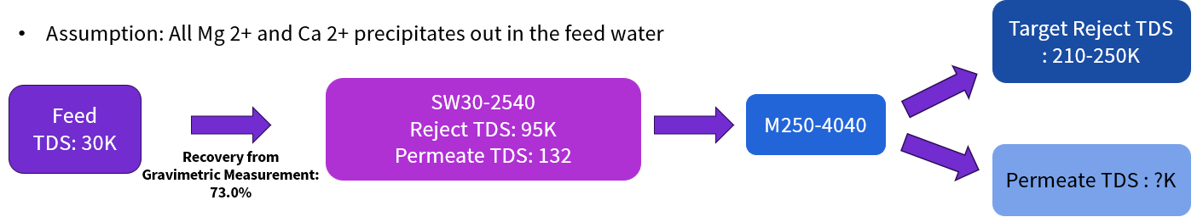
Objectives
To investigate the F - and SO4 2- rejection of M250-4040 and determine if it is capable of separating these two ions to inhibit Kogarkoite formation in both reject and permeate stream.

Slide 41
Test Method
Prepare Synthetic RO Feed – 250L
Perform pretreatment testing
Perform ROI concentration testing
Generate tap water permeate using SWRO membrane to minimize [Ca 2+]
Prepare synthetic feed based on the client’s feed water quality report using tap water permeate
Perform water analysis on the synthetic RO feed
Perform antiscalant projections to determine necessity of pretreatment, antiscalant type, and dosage
Dose 3.58ppm Vitec 4000 every 2 hours.
Load M250 membrane into pressure vessel
Start the pumps to circulate the feed water into the system with reject returned into feed tank while permeate is collected separately
Record flow rates, pressures & refractive index (conversion to TDS by calibration curve) at regular intervals
Collect samples of feed, permeate & reject at selected concentrations.
Stop current ROI stage testing when either feed volume has depleted, reject has reached concentration, or flux has reached minimum threshold
Collect samples of feed, permeate & reject for water analysis

Slide 42
M250 Trial Feed Water Analysis
PARAMETER | METHOD | UNIT | RO Reject | Synthetic CFRO Feed
pH | pH probe | - | 8.32 | 8.32
Conductivity | Conductivity probe | µS/cm | 100300 | 101700
Hydroxide, OH Alkalinity | APHA 2320B | CaCO₃ mg/l | <2 | <2
Carbonate Alkalinity, CO3/ P-Alkalinity | APHA 2320B | CaCO₃ mg/l | <2 | <2
Bicarbonate Alkalinity, HCO3/ M-Alkalinity | APHA 2320B | CaCO₃ mg/l | 1864 | 2260
Total Alkalinity | APHA 2320B | CaCO₃ mg/l | 1864 | 2260
Fluoride as F | Ion Chromatography | mg/l | 2584 | 2613
Chloride as Cl | Ion Chromatography | mg/l | 28698 | 28824
Sulphate as SO₄ | Ion Chromatography | mg/l | 30286 | 28676
Nitrate as NO₃ | Ion Chromatography | mg/l | 929 | 996
Ammonia as NH₃ | Hach 10031 | mg/l | 396 | 304
Calcium as Ca | EPA200.7 | mg/l | <1 | <1
Magnesium as Mg | EPA200.7 | mg/l | <1 | <1
Silica SiO2 | EPA200.7/ Calculation | mg/l | 39.51 | 46.5
Sodium as Na | EPA200.7 | mg/l | 37300 | 36640
Total Hardness as CaCO3 | APHA 2340B | mg/l | <1 | <1
TDS | APHA 2540C | mg/l | 95200 | 99040
TDS | Ultrameter (NaCl) | mg/l | 74140 | 77520
Turbidity | APHA 2130B | NTU | 0.624 | 0.315
TSS | Photometric | mg/l | <3 | <3
TSS | APHA 2540D | mg/l | - | -
Total Chlorine | Hach 8021 | mg/l | 0.1 | 0.03
PARAMETER | METHOD | UNIT | RO Reject | Synthetic CFRO Feed
Free Chlorine | Hach 8021 | mg/l | 0.1 | 0.02
Total Ions | Calculation | mg/l | 102097 | 100360
TDS & Total Ions Difference (by Gravimetry) | Calculation | % | 6.76 | 1.32
TDS & Total Ions Difference (by Ultrameter) | Calculation | % | 27.4 | 22.8
Salts Used | Feed Volume (L) | Mass of salts required (g) | Actual Mass of salts used (g)
NH42SO4 | 250 | 350 | 350
NaHCO3 | 250 | 782.5 | 783
NaF | 250 | 1427.5 | 1427
NaNO3 | 250 | 317.5 | 317
Na2SO4 | 250 | 10820 | 10820
NaCl | 250 | 11827.5 | 11828
Na2SiO3 | 250 | 20 | 25

Slide 43
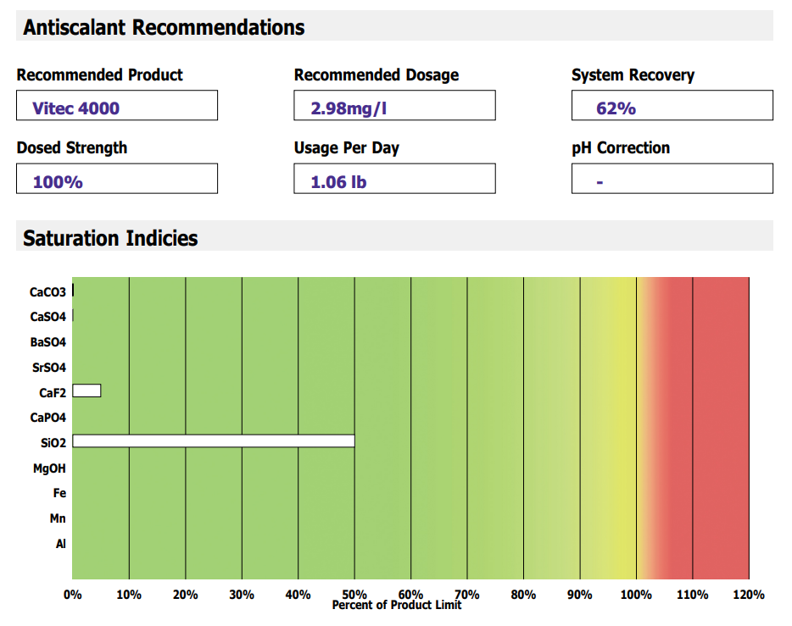
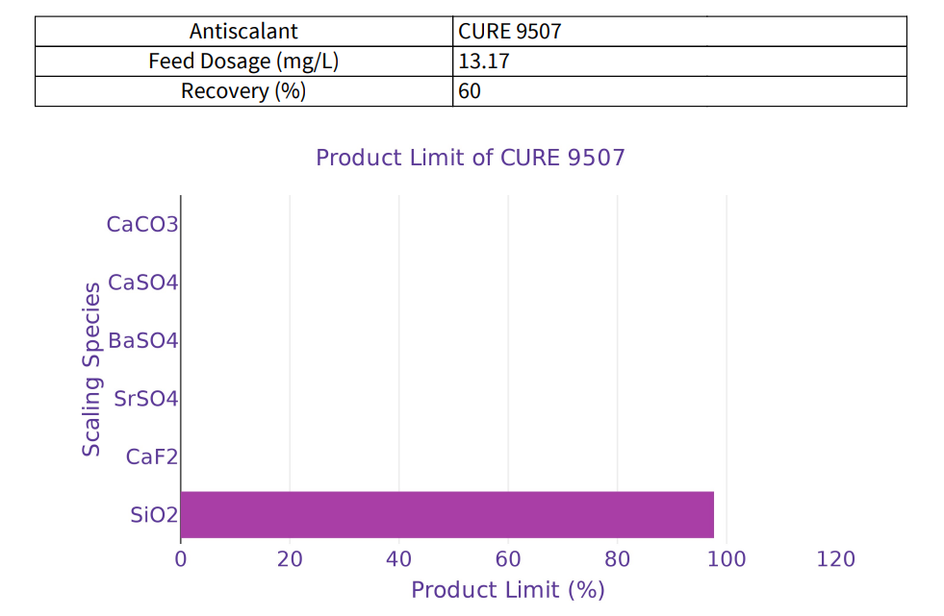
Anti-scalant Projection
Target recovery: 62%
Reject TDS Projected: 258,606 mg/L
Antiscalant: Vitec 4000 (CURE 9507) @ 3.58 ppm

Slide 44
CFRO Concentration Results
The feed was concentrated from 99,040 mg/L to 333,090 mg/L TDS.
Recovery obtained from gravimetric measurement of TDS is 70.3%.
The final CFRO permeate TDS obtained is 65,680 mg/L.
Operating parameters:
Feed pressure: 1000 psi (69 bar)
Flow rate: 18 LPM
Temperature: 25̊ C
Membrane: M250-4040

Slide 45
M250 Trial Water Analysis Results
PARAMETER | METHOD | UNIT | Synthetic CFRO Feed | M250 Reject | M250 Permeate
pH | pH probe | - | 8.32 | 8.44 | 8.56
Conductivity | Conductivity probe | µS/cm | 101700 | - | 85400
Hydroxide, OH Alkalinity | APHA 2320B | CaCO₃ mg/l | <2 | <2 | <2
Carbonate Alkalinity, CO3/ P-Alkalinity | APHA 2320B | CaCO₃ mg/l | <2 | <2 | <2
Bicarbonate Alkalinity, HCO3/ M-Alkalinity | APHA 2320B | CaCO₃ mg/l | 2260 | 2671 | 2290
Total Alkalinity | APHA 2320B | CaCO₃ mg/l | 2260 | 2671 | 2290
Fluoride as F | Ion Chromatography | mg/l | 2613 | 1970 | 2579
Chloride as Cl | Ion Chromatography | mg/l | 28824 | 11462 | 30695
Sulphate as SO₄ | Ion Chromatography | mg/l | 28676 | 203447 | 5735
Nitrate as NO₃ | Ion Chromatography | mg/l | 996 | 459 | 1502
Ammonia as NH₃ | Hach 10031 | mg/l | 304 | 850 | 204
Calcium as Ca | EPA200.7 | mg/l | <1 | <2 | <1
Magnesium as Mg | EPA200.7 | mg/l | <1 | <2 | <1
Silica SiO2 | EPA200.7/ Calculation | mg/l | 46.48 | 52.7 | 38.9
Sodium as Na | EPA200.7 | mg/l | 36640 | 117400 | 25640
Total Hardness as CaCO3 | APHA 2340B | mg/l | <1 | <2 | <1
TDS | APHA 2540C | mg/l | 99040 | 333090 | 65680
TDS | Ultrameter (NaCl) | mg/l | 77520 | 102200 | 62030
Turbidity | APHA 2130B | NTU | 0.315 | 3.46 | 0.306
TSS | Photometric | mg/l | <3 | <3 | <3
Total Chlorine | Hach 8021 | mg/l | 0.03 | 0.12 | 0.02
Free Chlorine | Hach 8021 | mg/l | 0.02 | 0.12 | 0.02
Total Ions | Calculation | mg/l | 100360 | 338311 | 68684
TDS & Total Ions Difference (by Gravimetry) | Calculation | % | 1.32 | 1.54 | 4.37
TDS & Total Ions Difference (by Ultrameter) | Calculation | % | 22.8 | 69.8 | 9.69

Slide 46
Sulphate to Fluoride Ratio
Ions | Units | OLi Projection |  |  | 180K TDS Reject (M150 Trial Experiment Values) | 330K TDS Reject (M250 Trial Experiment Values)
 |  | Target 218K TDS Reject | 160K TDS Reject | 210K TDS Reject
SO4 | ppm | 66619 | 49536 | 66619 | 74842 | 203447
F | ppm | 7169 | 5331 | 2488 | 5190 | 1970
Ratio | - | 9.29 | 9.29 | 26.8 | 14.4 | 103
No Kogarkoite precipitation

Slide 47
M250 Species Rejection
M250 has rejections for:
Sulphate and Sodium throughout the process
Silica when Feed TDS <= 225,562 mg/L
Fluoride when Feed TDS <= 140,620 mg/L
M250 has negative rejections for:
Chloride throughout the process
Nitrate throughout the process

Slide 48
M250 Species Rejection
Feed TDS (mg/L) | 125822 | 140620 | 181466 | 225562 | 285700 | 306830 | 333090
Feed [F -] (mg/L) | 2906 | 3017 | 2935 | 2574 | 2072 | 2006 | 1970
Permeate [F -] (mg/L) | 2307 | 2511 | 3119 | 3577 | 3654 | 3845 | 3628
Fluoride Rejection (%) | 20.6 | 16.8 | -6.3 | -38.9 | -76.4 | -91.6 | -84.2
Feed [SO4 2-] (mg/L) | 61118 | 77068 | 108914 | 151464 | 135558 | 182374 | 203447
Permeate [SO4 2-] (mg/L) | 2389 | 2908 | 5593 | 13988 | 25185 | 32612 | 57900
Sulphate Rejection (%) | 96.1 | 96.2 | 94.9 | 90.8 | 81.4 | 82.1 | 71.5
Feed [Cl -] (mg/L) | 27824 | 27491 | 23958 | 19131 | 18500 | 17310 | 15470
Permeate [Cl -] (mg/L) | 29352 | 30668 | 34307 | 34621 | 33346 | 33320 | 29431
Chloride Rejection (%) | -5.49 | -11.6 | -43.2 | -81.0 | -80.3 | -92.5 | -90.3
Feed [NO3 -] (mg/L) | 992 | 963 | 887 | 794 | 760 | 733 | 459
Permeate [NO3 -] (mg/L) | 1235 | 1223 | 1276 | 1314 | 1193 | 1134 | 1115
Nitrate Rejection (%) | -24.4 | -27.0 | -43.9 | -65.4 | -57.1 | -54.8 | -143
Feed [Na +] (mg/L) | 52700 | 58600 | 69550 | 92850 | 105200 | 104800 | 117400
Permeate [Na +] (mg/L) | 23980 | 26540 | 31400 | 35840 | 40520 | 46465 | 55300
Sodium Rejection (%) | 54.5 | 54.7 | 54.9 | 61.4 | 61.5 | 55.7 | 52.9
Feed [SiO2] (mg/L) | 41.3 | 62.1 | 58.9 | 65.7 | 56.9 | 47.8 | 52.7
Permeate [SiO2] (mg/L) | 34.4 | 41.9 | 51.7 | 59.0 | 66.7 | 75.5 | 83.8
Silica Rejection (%) | 16.7 | 32.5 | 12.3 | 10.2 | -17.3 | -57.9 | -59.0

Slide 49
CFRO Flux against Feed TDS Graph
Recommended Final M250 Reject TDS: ~307K mg/L when flux ~5 LMH.

Slide 50
CFRO Rejection against Feed TDS Graph

Slide 51
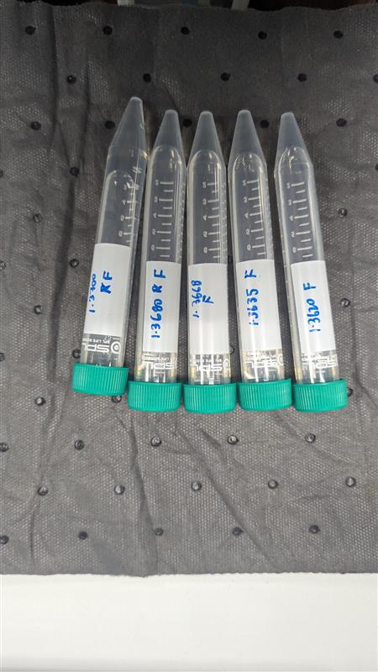
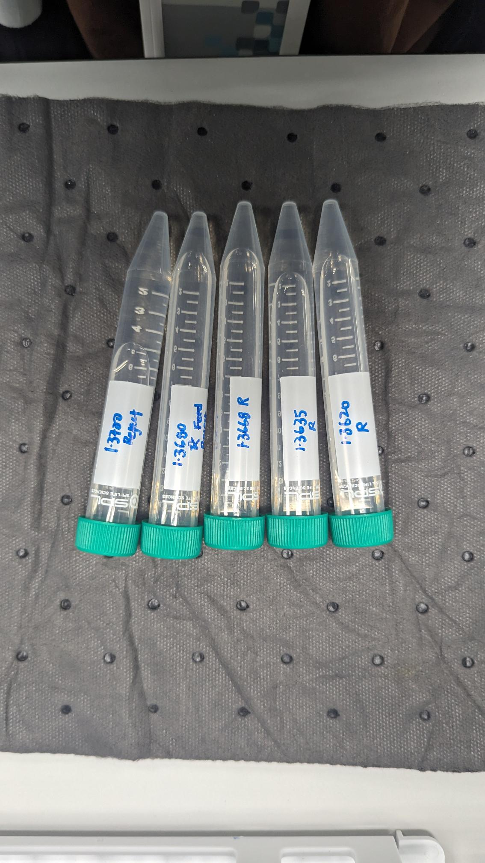
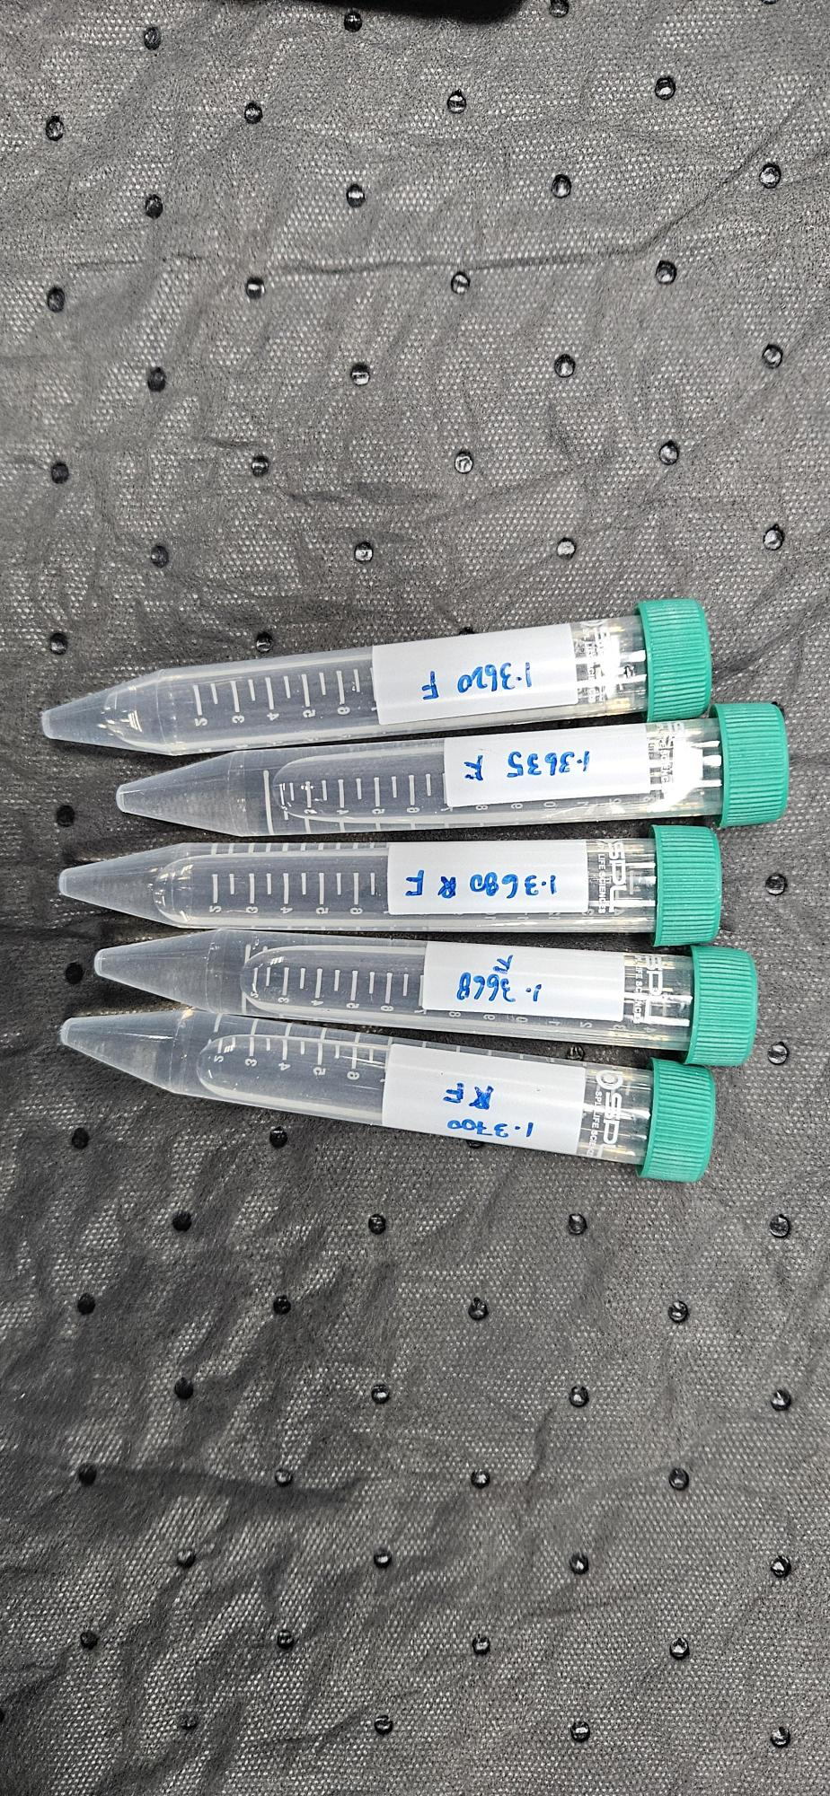
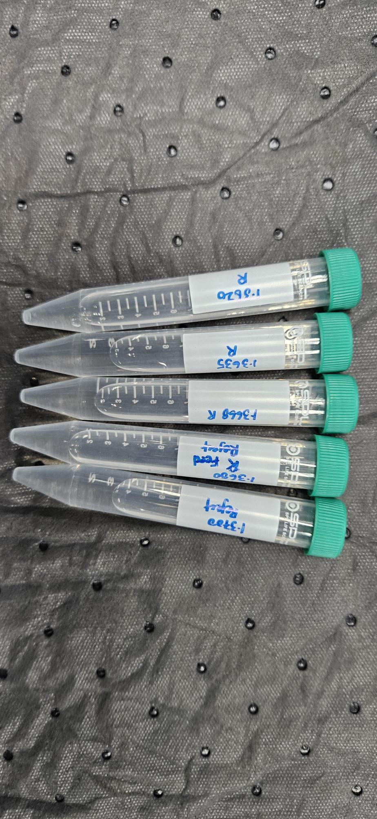
Sample Photos
Feed and reject samples from 238,980 mg/L (Labelled as RI = 1.3620) to 330,090 mg/L (Labelled as RI = 1.3700) were collected.
No precipitation formed after 3 days.
Day 1
Day 4

Slide 52
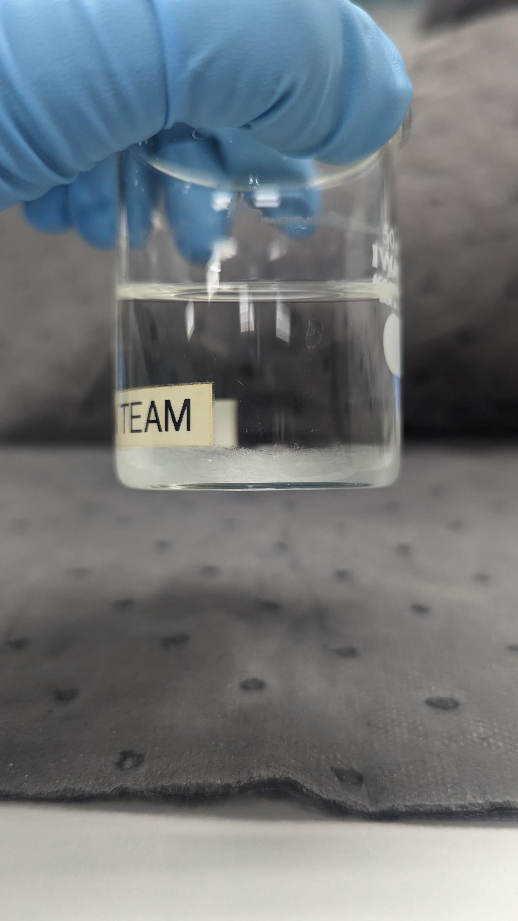
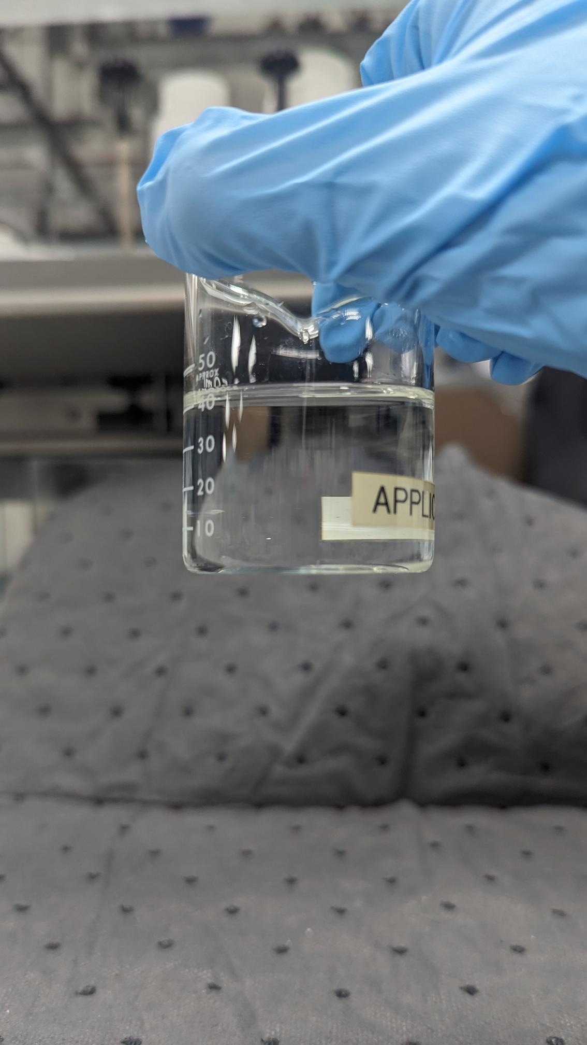
Observations
TDS: 333,090 mg/L
TDS: 306,830 mg/L
Precipitation observed in final reject after 4 days.
No precipitation observed in instantaneous reject (TDS: 306,830 mg/L) collected.

Slide 53
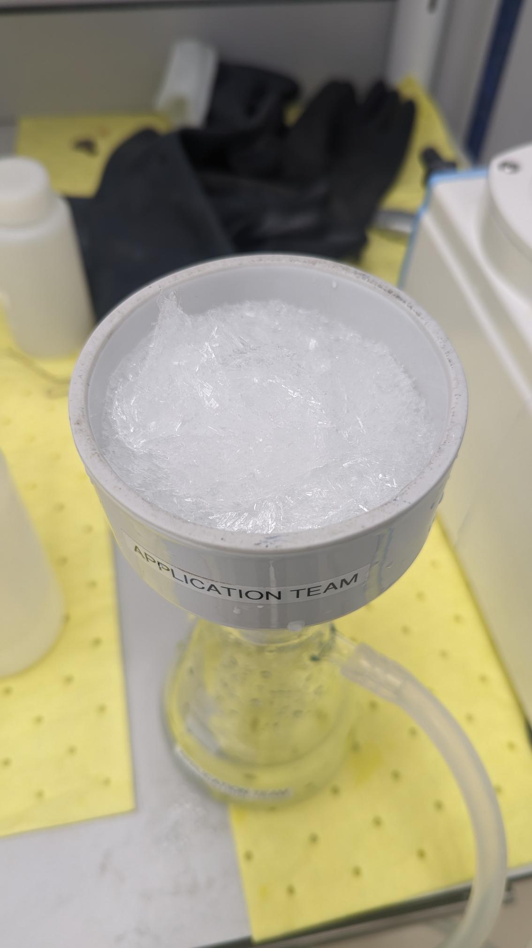
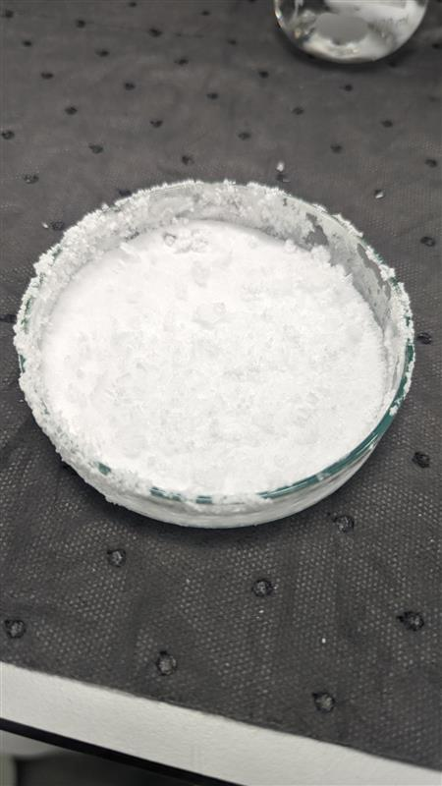
Salt Analysis
Filter the reject.
Dry the solid salts and perform salt analysis.
Precipitated salt is mainly sodium sulphate (Na2SO4).
Parameters | [Ion] (mg/L) | Percentage Composition (%)
Fluoride as F | 2.17 | 0.103
Chloride as Cl | 17.4 | 0.825
Sulphate as SO₄ | 1383 | 65.6
Silica SiO2 | < 0.2 | -
Sodium as Na | 636 | 30.1

Slide 54
M250 Trial Conclusions
The feed was concentrated from 99,040 mg/L to 333,090 mg/L TDS.
Recovery obtained from gravimetric measurement of TDS is 70.3%.
The final CFRO permeate TDS obtained is 65,680 mg/L.
Recommended final M250 reject TDS: ~ 307K mg/L when flux ~5 LMH.
M250 has rejections for:
Sulphate and Sodium throughout the process
Silica when Feed TDS <= 225,562 mg/L
Fluoride when Feed TDS <= 140,620 mg/L
M250 has negative rejections for:
Chloride throughout the process
Nitrate throughout the process
Precipitation was observed in the reject after four days and the precipitated salt is sodium sulphate (Na2SO4).

Slide 55
Summary
Recovery by
Gravimetric Measurement: 70.3%
Target Reject TDS : 330K (60L)
Assumption: All Mg 2+ and Ca 2+ precipitates out in the feed water
Feed
TDS: 30K
SW30-2540
Reject TDS: 95K (215L)
Permeate TDS: 132
M250-4040
Recovery from
Gravimetric Measurement: 73.0%
Permeate TDS : 65K (155L)
M250 Permeate Stream (Stream 1) Treatment:
Recovery by Volume: 72.1%
M250
Permeate TDS : 65K
Fluoride Removal
Pre-treatment:
CaCl2/Ca(OH)2 Dosage
M150 + M250
Target Reject TDS: 210-250K
Run OLi projections and conduct jar tests to determine the dosing chemical and its optimal dosage for Stream 1 fluoride removal.

Slide 56
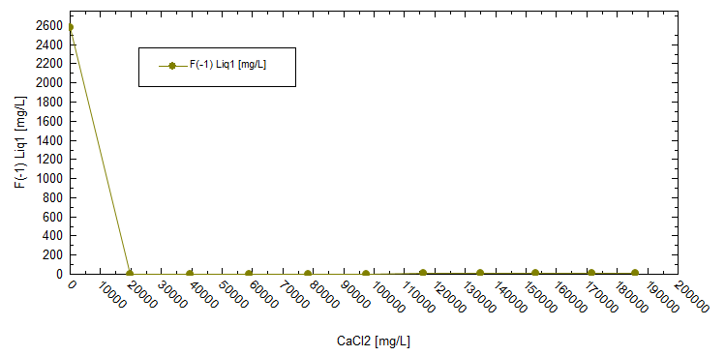
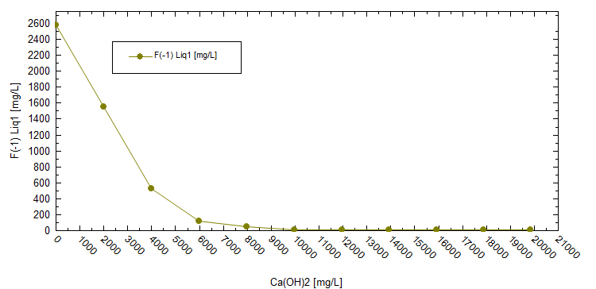
OLi Projections
CaCl2 Dosage for Optimal Fluoride Removal: 19,831 mg/L
Ca(OH)2 Dosage for Optimal Fluoride Removal: 9965 mg/L

Slide 57
OLi Projections
Case | CaCl2 Dosage (mg/L) | Residual [Ca 2+] (mg/L) | Final [F -] (mg/L) | Final pH | Final TDS (mg/L) | Other PPT formed
Initial | - | - | 2579 | 8.97 | 70891 | -
1 | 19831 | 2615 | 2.44 | 6.05 | 79689 | CaCO3 CaSO4.2H20
2 | 10000 | 252 | 4.84 | 6.79 | 73933 | CaCO3
Case | Ca(OH)2 Dosage (mg/L) | Residual [Ca 2+] (mg/L) | Final [F -] (mg/L) | Final pH | Final TDS (mg/L) | Other PPT formed
Initial | - | - | 2579 | 8.97 | 70891 | -
3 | 9965 | 278 | 5.99 | 13.02 | 69180 | Ca3Si2O6(OH)2.2H2O CaCO3 Ca(OH)2
Case 2 and 3 will be tested to verify the OLi projections.

Slide 58
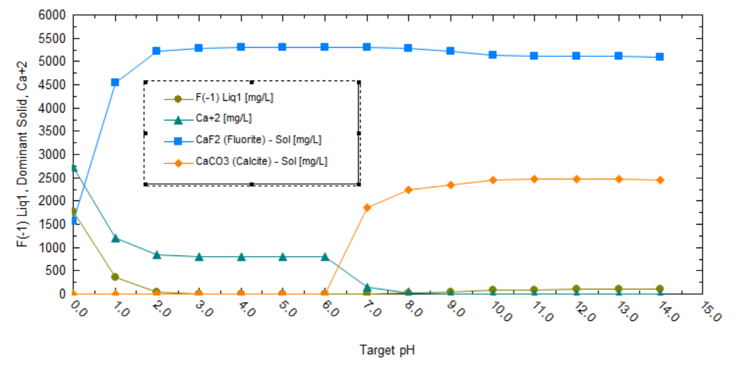
CaCl2 Dosage: pH adjustment
pH adjustment to higher pH will not enhance fluoride removal.
pH adjustment to 8 and above significantly reduce residual [Ca 2+] due to CaCO3 precipitation.

Slide 59
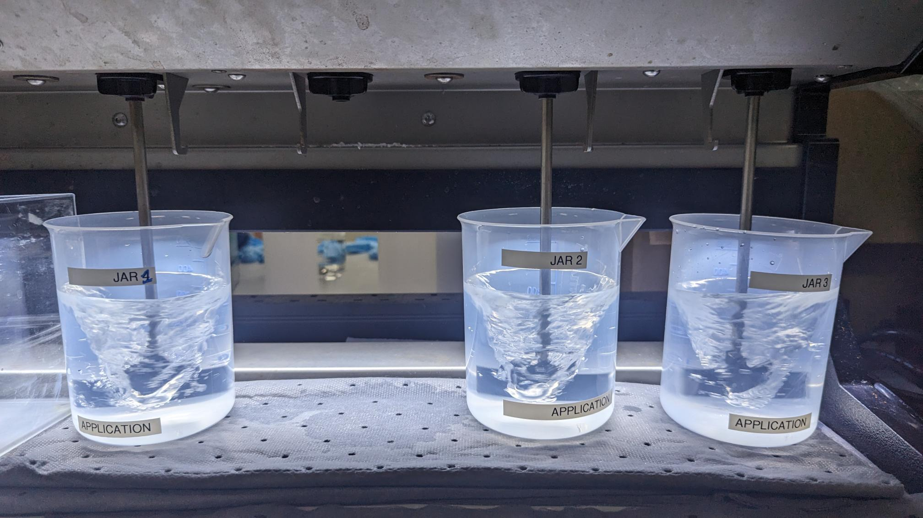
Test Method
Conduct jar test according to the table below:
Stir the solution mixture at 400RPM for the first five minutes.
Stir the solution mixture at 40RPM for 30 minutes.
Filter and collect the filtrate, adjust the pH to 6 using 10% HCl if filtrate pH value is > 9.
Send the filtrate for water analysis.
Jar | Feed Volume (mL) | pH | Ca(OH)2 Dosage (mg/L) | CaCl2 Dosage (mg/L)
0 (Control) | 300 | 8.56 | 0 | 0
1 | 300 | 8.56 | 9965 | 0
2 | 300 | 8.56 | 0 | 10000
3 | 300 | 11 | 0 | 10000
Jar Test Set-Up

Slide 60
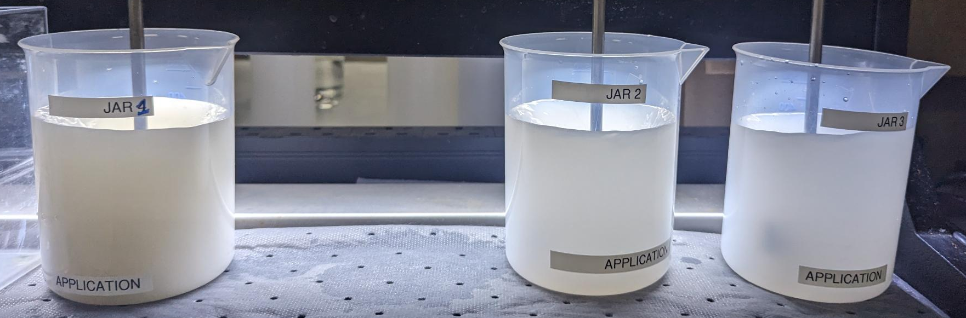
Observations
Before Ca Dosage
After Ca Dosage

Slide 61
Water Analysis Results
Jar | Initial pH | pH after Chemical Dosage | pH after Filtration | 10% HCl Dosage (mL) | pH after Adjustment
0 (Control) | 8.42 | 8.42 | - | - | -
1 | 8.42 | 13.05 | 13.09 | 15 | 6.01
2 | 8.42 | 7.49 | 7.87 | - | -
3 | 11 | 10.57 | 10.51 | 3.6 | 6.04
Parameters | Units | Jar 0 (Control) | Jar 1 | Jar 2 | Jar 3
Ca(OH)2 Dosage | mg/L | - | 9965 | 0 | 0
CaCl2 Dosage | mg/L | - | 0 | 10000 | 10000
Feed pH | - | 8.42 | 8.42 | 8.42 | 8.42
Final pH | - | - | 6.01 | 7.87 | 6.01
Hydroxide, OH Alkalinity | CaCO₃ mg/l | <2 | <2 | <2 | <2
Carbonate Alkalinity, CO3/ P-Alkalinity | CaCO₃ mg/l | <2 | <2 | <2 | <2
Bicarbonate Alkalinity, HCO3/ M-Alkalinity | CaCO₃ mg/l | 2290 | 299 | 1117 | 415
Total Alkalinity | CaCO₃ mg/l | 2290 | 364.51 | 1117 | 415
Fluoride as F | mg/L | 2212 | 81.6 | 30.9 | 30.9
Chloride as Cl | mg/L | 27248 | 29726 | 31910 | 31780
Sulphate as SO₄ | mg/L | 5786 | 5356 | 5216 | 5198
Nitrate as NO₃ | mg/L | 332 | 332 | 331 | 332
Calcium as Ca | mg/L | <1 | 21 | 79 | 16
Silica SiO2 | mg/L | 38.9 | 1.42 | 38.35 | 15.05
Sodium as Na | mg/L | 25640 | 22180 | 23020 | 24020
TDS (Gravimetry) | mg/L | 65680 | 62940 | 66700 | 66680

Slide 62
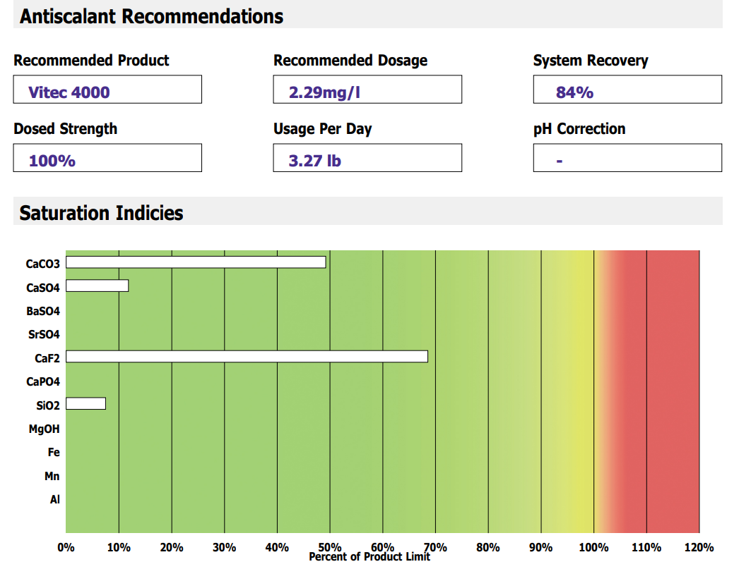
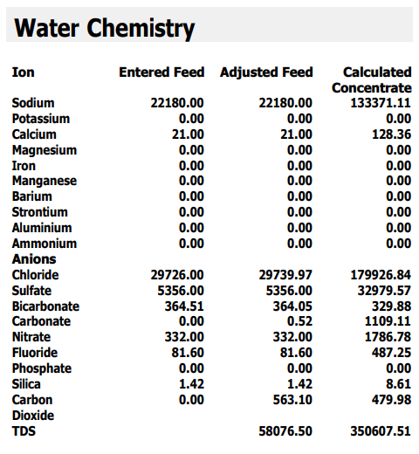
Maximum Recovery according to Anti-scalant Projection: Jar 1

Slide 63
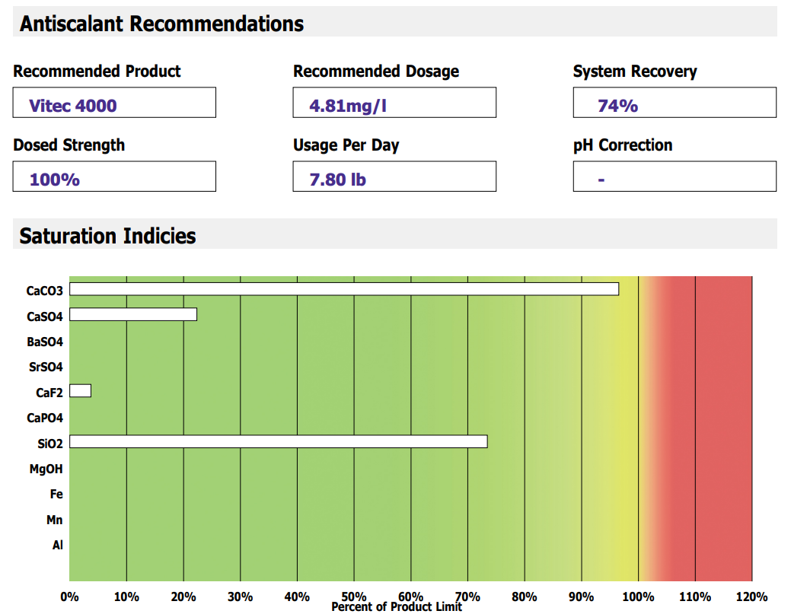
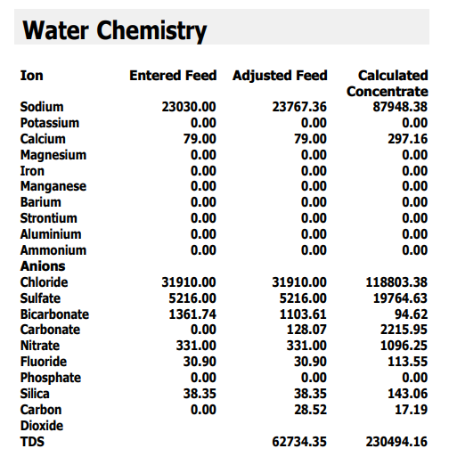
Maximum Recovery according to Anti-scalant Projection: Jar 2

Slide 64
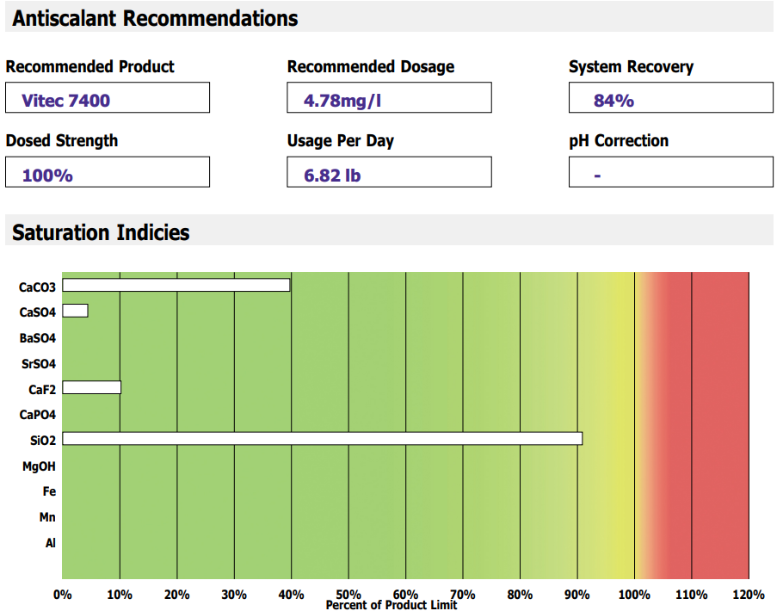
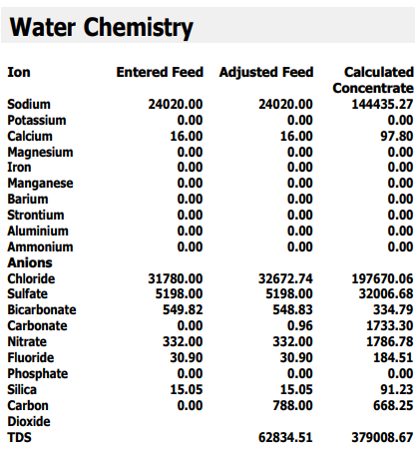
Maximum Recovery according to Anti-scalant Projection: Jar 3

Slide 65
Results and Discussions
Jar | [F -] (mg/L) | Residual [Ca 2+] (mg/L) | Chemical Dosage (mg/L) | TDS after Fluoride Removal (mg/L) | Maximum Reject TDS according to Projection Tool (mg/L)
1 | 81.6 | 21 | Ca(OH)2: 9965 HCl | 62,940 | 350,608
2 | 30.9 | 79 | CaCl2: 10,000 HCl | 66,700 | 230,494
3 | 30.9 | 16 | NaOH CaCl2: 10,000 HCl | 66,680 | 379,008
CaCl2 results in higher fluoride removal and lower residual calcium as compared to Ca(OH)2 with pH adjustment to 11 before chemical dosage, more Ca 2+ was removed as high pH enhances CaCO3 precipitation.
RO treatment is required for both chemicals used as the TDS values after fluoride removal treatment were less than 80,000 mg/L.
Both Ca(OH)2 and CaCl2 treated feed can be concentrated to comparable maximum reject TDS (350,608 mg/L for Ca(OH)2 treated feed and 379,008 mg/L for CaCl2 treated feed).
Ca(OH)2 is used for this pre-treatment as it has similar performance as CaCl2 with less chemical dosage.

Slide 66
Summary
Recovery by
Gravimetric Measurement: 70.3%
Target Reject TDS : 330K (60L)
Assumption: All Mg 2+ and Ca 2+ precipitates out in the feed water
Feed
TDS: 30K
SW30-2540
Reject TDS: 95K (215L)
Permeate TDS: 132
M250-4040
Recovery from
Gravimetric Measurement: 73.0%
Permeate TDS : 65K (155L)
M250 Permeate Stream (Stream 1) Treatment:
Recovery by Volume: 72.1%
RO Trial
CFRO Trial
M250
Permeate TDS : 65K
Fluoride Removal
Pre-treatment:
CaCl2/Ca(OH)2 Dosage:
9965 mg/L
TDS: 63K (60L)
SW30:
Target Reject TDS: 80K
M150 + M250
Target Reject TDS: 210-250K
Prepare 60L 63K synthetic M250 permeate after fluoride removal treatment for RO trial.
Prepare ~80K synthetic RO reject for CFRO trial.

Slide 67
Test Method
Prepare Synthetic RO Feed – 60L
Perform pretreatment testing
Perform ROI concentration testing
Generate tap water permeate using SWRO membrane to minimize [Ca 2+]
Prepare synthetic feed based on the jar test results using tap water permeate
Perform water analysis on the synthetic RO feed
Perform antiscalant projections to determine necessity of pretreatment, antiscalant type, and dosage
Dose 2ppm CURE 9507 every 2 hours.
Load SWRO membrane into pressure vessel
Start the pumps to circulate the feed water into the system with reject returned into feed tank while permeate is collected separately
Record flow rates, pressures & refractive index (conversion to TDS by calibration curve) at regular intervals
Stop current ROI stage testing when flux has reached minimum threshold
Collect samples of feed, permeate & reject for water analysis
Prepare synthetic feed for CFRO run using the RO reject water analysis report
Load CFRO membrane & operate as the next stage as needed

Slide 68
Stream 1 RO Trial Feed Water Analysis
PARAMETER | METHOD | UNIT | M250 Permeate after pre-treatment | Synthetic Stream 1 RO Feed
pH | pH probe | - | 6.01 | 7.94
Conductivity | Conductivity probe | µS/cm | 83900 | 76700
Hydroxide, OH Alkalinity | APHA 2320B | CaCO₃ mg/l | <2 | <2
Carbonate Alkalinity, CO3/ P-Alkalinity | APHA 2320B | CaCO₃ mg/l | <2 | <2
Bicarbonate Alkalinity, HCO3/ M-Alkalinity | APHA 2320B | CaCO₃ mg/l | 299 | 281
Total Alkalinity | APHA 2320B | CaCO₃ mg/l | 365 | 281
Fluoride as F | Ion Chromatography | mg/l | 81.6 | 74
Chloride as Cl | Ion Chromatography | mg/l | 29726 | 28188
Sulphate as SO₄ | Ion Chromatography | mg/l | 5356 | 5171
Nitrate as NO₃ | Ion Chromatography | mg/l | 1274 | 1185
Ammonia as NH₃ | Hach 10031 | mg/l | 147 | 116
Calcium as Ca | EPA200.7 | mg/l | 21 | 16.6
Magnesium as Mg | EPA200.7 | mg/l | <0.1 | <0.1
Silica SiO2 | EPA200.7/ Calculation | mg/l | 1.42 | 1.81
Sodium as Na | EPA200.7 | mg/l | 22180 | 23400
Total Hardness as CaCO3 | APHA 2340B | mg/l | 52.5 | 41.5
TDS | APHA 2540C | mg/l | 62940 | 56400
TDS | Ultrameter (NaCl) | mg/l | 60050 | 53400
Turbidity | APHA 2130B | NTU | 0.618 | 0.721
PARAMETER | METHOD | UNIT | M250 Permeate after pre-treatment | Synthetic Stream 1 RO Feed
TSS | Photometric | mg/l | <3 | 0.721
Total Chlorine | Hach 8021 | mg/l | 0.02 | <3
Free Chlorine | Hach 8021 | mg/l | 0.02 | 0.05
Total Ions | Calculation | mg/l | 59005 | 58301
TDS & Total Ions Difference (by Gravimetry) | Calculation | % | -6.67 | 3.26
TDS & Total Ions Difference (by Ultrameter) | Calculation | % | -1.77 | 8.41
Salts | Mass of Salts required for 1L Feed (g) | Volume of Feed (L) | Mass of Salts required (g) | Actual Mass of Salts used (g)
CaCl2 | 0.058 | 50 | 2.91 | 2.91
(NH4)2SO4 | 0.571 | 50 | 28.6 | 28.6
NaHCO3 | 0.502 | 50 | 25.1 | 25.1
NaF | 0.180 | 50 | 9.02 | 9.01
Na2SiO3 | 0.003 | 50 | 0.145 | 0.153
Na2SO4 | 7.31 | 50 | 365 | 365
NaCl | 48.9 | 50 | 2447 | 2447
NaNO3 | 1.72 | 50 | 85.9 | 86.0

Slide 69
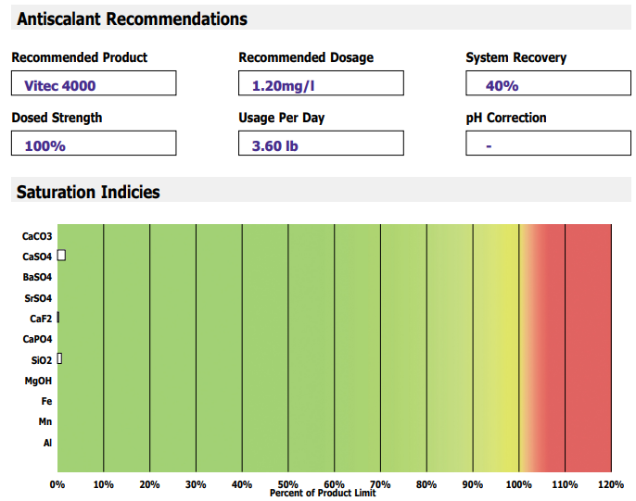
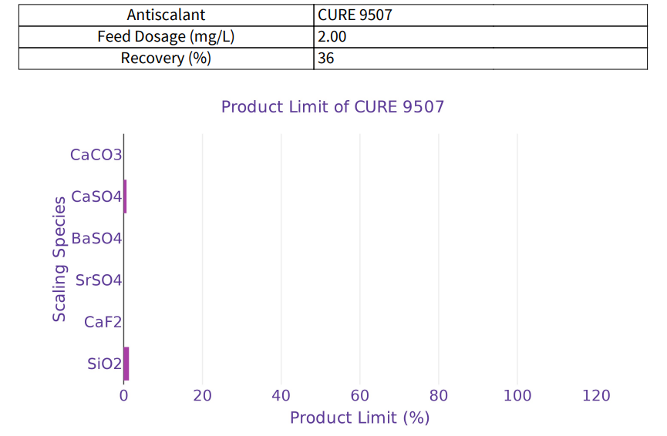
Anti-scalant Projection
Target recovery: 40%
Projected Reject TDS: 92,622 mg/L
Antiscalant: CURE 9507 @ 2.00 ppm

Slide 70
Stream 1 RO Concentration Results
The feed was concentrated from 56,400 mg/L to 89,000 mg/L TDS.
Recovery obtained from gravimetric measurement of TDS is 36.6%.
The final RO permeate TDS obtained is 593 mg/L.
Operating parameters:
Feed pressure: 1000 psi (69 bar)
Flow rate: 10 - 11 LPM
Temperature: 25̊ C
Membrane: Dupont FilmTec SW30-2540

Slide 71
Stream 1 RO Trial Water Analysis Results
PARAMETER | METHOD | UNIT | Synthetic Stream 1 RO Feed | Stream 1 RO Reject | Stream 1 RO Permeate
pH | pH probe | - | 7.94 | 7.78 | 8.89
Conductivity | Conductivity probe | µS/cm | 76700 | 110800 | 1561
Hydroxide, OH Alkalinity | APHA 2320B | CaCO₃ mg/l | <2 | <2 | <2
Carbonate Alkalinity, CO3/ P-Alkalinity | APHA 2320B | CaCO₃ mg/l | <2 | <2 | <2
Bicarbonate Alkalinity, HCO3/ M-Alkalinity | APHA 2320B | CaCO₃ mg/l | 281 | 452 | 31
Total Alkalinity | APHA 2320B | CaCO₃ mg/l | 281 | 452 | 31
Fluoride as F | Ion Chromatography | mg/l | 74 | 117 | 0.755
Chloride as Cl | Ion Chromatography | mg/l | 28188 | 45840 | 485
Sulphate as SO₄ | Ion Chromatography | mg/l | 5171 | 9020 | 27.3
Nitrate as NO₃ | Ion Chromatography | mg/l | 1185 | 2677 | 91.2
Ammonia as NH₃ | Hach 10031 | mg/l | 116 | 179 | 6.6
Calcium as Ca | EPA200.7 | mg/l | 16.6 | 27.2 | <0.1
Magnesium as Mg | EPA200.7 | mg/l | <0.1 | <0.1 | <0.1
Silica SiO2 | EPA200.7/ Calculation | mg/l | 1.81 | 3.94 | <0.2
Sodium as Na | EPA200.7 | mg/l | 23400 | 35060 | 331
Total Hardness as CaCO3 | APHA 2340B | mg/l | 41.5 | 67.9 | <0.1
TDS | APHA 2540C | mg/l | 56400 | 89000 | 593
TDS | Ultrameter (NaCl) | mg/l | 53400 | 84190 | 729
Turbidity | APHA 2130B | NTU | 0.721 | 0.943 | 0.249
TSS | Photometric | mg/l | <3 | <3 | <3
Total Chlorine | Hach 8021 | mg/l | 0.05 | 0.06 | 0.02
Free Chlorine | Hach 8021 | mg/l | 0.05 | 0.05 | 0.02
Total Ions | Calculation | mg/l | 58318 | 92746 | 966
TDS & Total Ions Difference (by Gravimetry) | Calculation | % | 3.29 | 4.04 | 38.63
TDS & Total Ions Difference (by Ultrameter) | Calculation | % | 8.43 | 9.23 | 24.55

Slide 72
Stream 1 RO Trial Flux against Feed TDS Graph

Slide 73
Stream 1 RO Trial Rejection against Feed TDS Graph

Slide 74
Stream 1 RO Trial Conclusions
The feed was concentrated from 56,400 mg/L to 89,000 mg/L TDS.
Recovery obtained from gravimetric measurement of TDS is 36.6%.
The final RO permeate TDS obtained is 593 mg/L.
Prepare synthetic Stream 1 RO reject for CFRO trial.

Slide 75
M250 Permeate Stream (Stream 1) Treatment:
RO Trial
CFRO Trial
Fluoride Removal
Pre-treatment:
CaCl2/Ca(OH)2 Dosage:
9965 mg/L
TDS: 63K (60L)
M250
Permeate TDS : 65K
SW30:
Reject TDS: 89K (30L)
M150 + M250
Target Reject TDS: 210-250K
Recovery by
Gravimetric Measurement/Volume: 36.6%
Prepare 450L 89K synthetic RO reject for CFRO trial.

Slide 76
Stream 1 M150 Trial Feed Water Analysis
PARAMETER | METHOD | UNIT | Stream 1 RO Reject | Stream 1 Synthetic CFRO Feed
pH | pH probe | - | 7.78 | 7.89
Conductivity | Conductivity probe | µS/cm | 110800 | 114900
Hydroxide, OH Alkalinity | APHA 2320B | CaCO₃ mg/l | <2 | <2
Carbonate Alkalinity, CO3 / P-Alkalinity | APHA 2320B | CaCO₃ mg/l | <2 | <2
Bicarbonate Alkalinity, HCO3/ M-Alkalinity | APHA 2320B | CaCO₃ mg/l | 452 | 445
Total Alkalinity | APHA 2320B | CaCO₃ mg/l | 452 | 445
Fluoride as F | Ion Chromatography | mg/l | 117 | 105
Chloride as Cl | Ion Chromatography | mg/l | 45840 | 43976
Sulphate as SO₄ | Ion Chromatography | mg/l | 9020 | 9112
Nitrate as NO₃ | Ion Chromatography | mg/l | 2677 | 3663
Ammonia as NH₃ | Hach 10031 | mg/l | 179 | 144
Calcium as Ca | EPA200.7 | mg/l | 27.2 | 23.3
Magnesium as Mg | EPA200.7 | mg/l | <0.1 | <0.1
Silica SiO2 | EPA200.7/ Calculation | mg/l | 3.94 | 4.67
Sodium as Na | EPA200.7 | mg/l | 35060 | 34700
Total Hardness as CaCO3 | APHA 2340B | mg/l | 67.9 | 58.3
TDS | APHA 2540C | mg/l | 89000 | 95140
TDS | Ultrameter (NaCl) | mg/l | 84190 | 88500
Turbidity | APHA 2130B | NTU | 0.943 | 0.237
TSS | Photometric | mg/l | <3 | <3
Total Chlorine | Hach 8021 | mg/l | 0.06 | 0.03
Free Chlorine | Hach 8021 | mg/l | 0.05 | 0.03
Total Ions | Calculation | mg/l | 92746 | 92172
TDS & Total Ions Difference (by Gravimetry) | Calculation | % | 4.04 | -3.22
TDS & Total Ions Difference (by Ultrameter) | Calculation | % | 9.23 | 3.98
Salts | Volume of Feed (L) | Mass of Salts required (g) | Actual Mass of Salts used (g)
CaCl2 | 450 | 33.9 | 42.0
(NH4)2SO4 | 450 | 313 | 313
NaHCO3 | 450 | 341 | 341
NaF | 450 | 116 | 116
Na2SiO3 | 450 | 3.60 | 3.61
Na2SO4 | 450 | 5666 | 5669
NaCl | 450 | 33967 | 30393
NaNO3 | 450 | 1651 | 1651

Slide 77
Stream 1 CFRO(M150) Concentration Results
The feed was concentrated from 95,140 mg/L to 180,540 mg/L TDS.
Recovery obtained from gravimetric measurement of TDS is 47.3%.
The final CFRO permeate TDS obtained is 94,690 mg/L.
Operating parameters:
Feed pressure: 800 psi (55 bar)
*M150-2540 has a lower pressure rating than M150-4040.
Flow rate: 10 - 11 LPM
Temperature: 25̊ C
Membrane: M150-2540

Slide 78
Stream 1 M150 Trial Water Analysis Results
PARAMETER | METHOD | UNIT | Stream 1 Synthetic CFRO Feed | Stream 1 M150 Reject | Stream 1 M150 Permeate
pH | pH probe | - | 8.13 | 7.9 | 7.99
Conductivity | Conductivity probe | µS/cm | 114900 | 163400 | 121800
Hydroxide, OH Alkalinity | APHA 2320B | CaCO₃ mg/l | <2 | <2 | <2
Carbonate Alkalinity, CO3/ P-Alkalinity | APHA 2320B | CaCO₃ mg/l | <2 | <2 | <2
Bicarbonate Alkalinity, HCO3/ M-Alkalinity | APHA 2320B | CaCO₃ mg/l | 445 | 1149 | 354
Total Alkalinity | APHA 2320B | CaCO₃ mg/l | 445 | 1149 | 354
Fluoride as F | Ion Chromatography | mg/l | 105 | 306 | 80.6
Chloride as Cl | Ion Chromatography | mg/l | 43976 | 77151 | 54460
Sulphate as SO₄ | Ion Chromatography | mg/l | 9112 | 37525 | 746
Nitrate as NO₃ | Ion Chromatography | mg/l | 3663 | 2564 | 4129
Ammonia as NH₃ | Hach 10031 | mg/l | 144 | 280 | 155
Calcium as Ca | EPA200.7 | mg/l | 23.3 | 41.0 | 7.4
Magnesium as Mg | EPA200.7 | mg/l | <0.1 | <0.1 | <0.1
Silica SiO2 | EPA200.7/ Calculation | mg/l | 4.67 | 8.86 | 3.82
Sodium as Na | EPA200.7 | mg/l | 34700 | 82340 | 44685
Total Hardness as CaCO3 | APHA 2340B | mg/l | 58.3 | 103 | 18.6
TDS | APHA 2540C | mg/l | 95140 | 180540 | 94690
TDS | Ultrameter (NaCl) | mg/l | 88500 | 133000 | 93930
Turbidity | APHA 2130B | NTU | 0.237 | 0.305 | 0.096
TSS | Photometric | mg/l | <3 | <3 | <3
Total Chlorine | Hach 8021 | mg/l | 0.03 | 0.07 | <0.02
Free Chlorine | Hach 8021 | mg/l | 0.03 | 0.07 | <0.02
Total Ions | Calculation | mg/l | 92172 | 201364 | 104622
TDS & Total Ions Difference (by Gravimetry) | Calculation | % | -3.22 | 10.3 | 9.49
TDS & Total Ions Difference (by Ultrameter) | Calculation | % | 3.98 | 34.0 | 10.2

Slide 79
Stream 1 CFRO (M150) Trial Flux against Feed TDS Graph

Slide 80
Stream 1 CFRO (M150) Trial Rejection against Feed TDS Graph

Slide 81
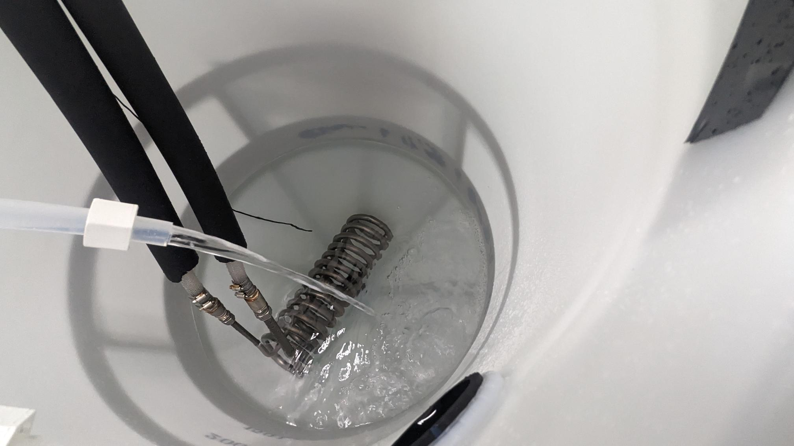
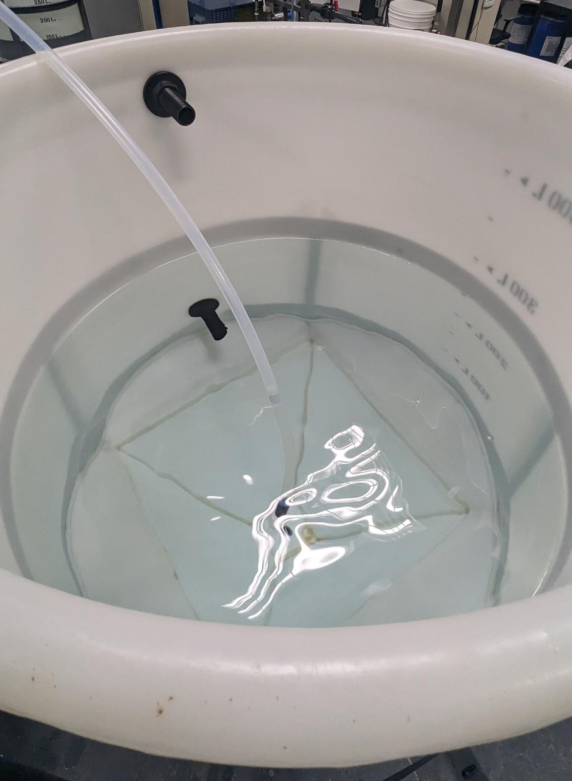
Sample Photos
181K Reject
95K Permeate
Both M150 reject and permeate are clear, no precipitation is observed.

Slide 82
Stream 1 CFRO(M250) Concentration Results
The feed was concentrated from 180,540 mg/L to 314,990 mg/L TDS.
Recovery obtained from gravimetric measurement of TDS is 42.7%.
The final CFRO permeate TDS obtained is 132,420 mg/L.
Operating parameters:
Feed pressure: 1000 psi (69 bar)
Flow rate: 18 LPM
Temperature: 25̊ C
Membrane: M250-4040

Slide 83
Stream 1 M250 Trial Water Analysis Results
PARAMETER | METHOD | UNIT | Stream 1 Synthetic CFRO Feed | Stream 1 M250 Reject | Stream 1 M250 Permeate
pH | pH probe | - | 8.13 | 8.29 | 8.46
Conductivity | Conductivity probe | µS/cm | 114900 | 161400 | 155700
Hydroxide, OH Alkalinity | APHA 2320B | CaCO₃ mg/l | <2 | <2 | <2
Carbonate Alkalinity, CO3/ P-Alkalinity | APHA 2320B | CaCO₃ mg/l | <2 | <2 | <2
Bicarbonate Alkalinity, HCO3/ M-Alkalinity | APHA 2320B | CaCO₃ mg/l | 445 | 1617 | 873
Total Alkalinity | APHA 2320B | CaCO₃ mg/l | 445 | 1617 | 873
Fluoride as F | Ion Chromatography | mg/l | 105 | 341 | 185
Chloride as Cl | Ion Chromatography | mg/l | 43976 | 70852 | 77714
Sulphate as SO₄ | Ion Chromatography | mg/l | 9112 | 153803 | 2623
Nitrate as NO₃ | Ion Chromatography | mg/l | 3663 | 3081 | 2801
Ammonia as NH₃ | Hach 10031 | mg/l | 144 | 850 | 207
Calcium as Ca | EPA200.7 | mg/l | 23.3 | 181 | 13.4
Magnesium as Mg | EPA200.7 | mg/l | <0.1 | 6.36 | <0.1
Silica SiO2 | EPA200.7/ Calculation | mg/l | 4.67 | 45.6 | 5.78
Sodium as Na | EPA200.7 | mg/l | 34700 | 113300 | 52050
Total Hardness as CaCO3 | APHA 2340B | mg/l | 58.3 | 453 | 33.6
TDS | APHA 2540C | mg/l | 95140 | 314990 | 132420
TDS | Ultrameter (NaCl) | mg/l | 88500 | 130100 | 123500
Turbidity | APHA 2130B | NTU | 0.237 | 0.861 | 0.0730
TSS | Photometric | mg/l | <3 | <3 | <3
Total Chlorine | Hach 8021 | mg/l | 0.03 | 0.19 | 0.04
Free Chlorine | Hach 8021 | mg/l | 0.03 | 0.13 | 0.04
Total Ions | Calculation | mg/l | 92172 | 344077 | 136472
TDS & Total Ions Difference (by Gravimetry) | Calculation | % | -3.22 | 8.45 | 2.97
TDS & Total Ions Difference (by Ultrameter) | Calculation | % | 3.98 | 62.19 | 9.51

Slide 84
Stream 1 M250 Trial Flux against Feed TDS Graph

Slide 85
Stream 1 M250 Trial Rejection against Feed TDS Graph

Slide 86
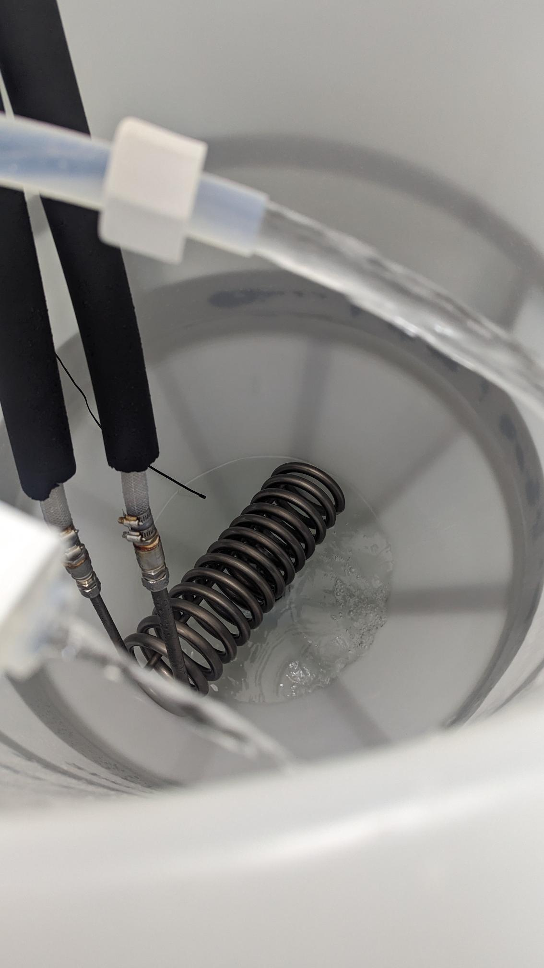
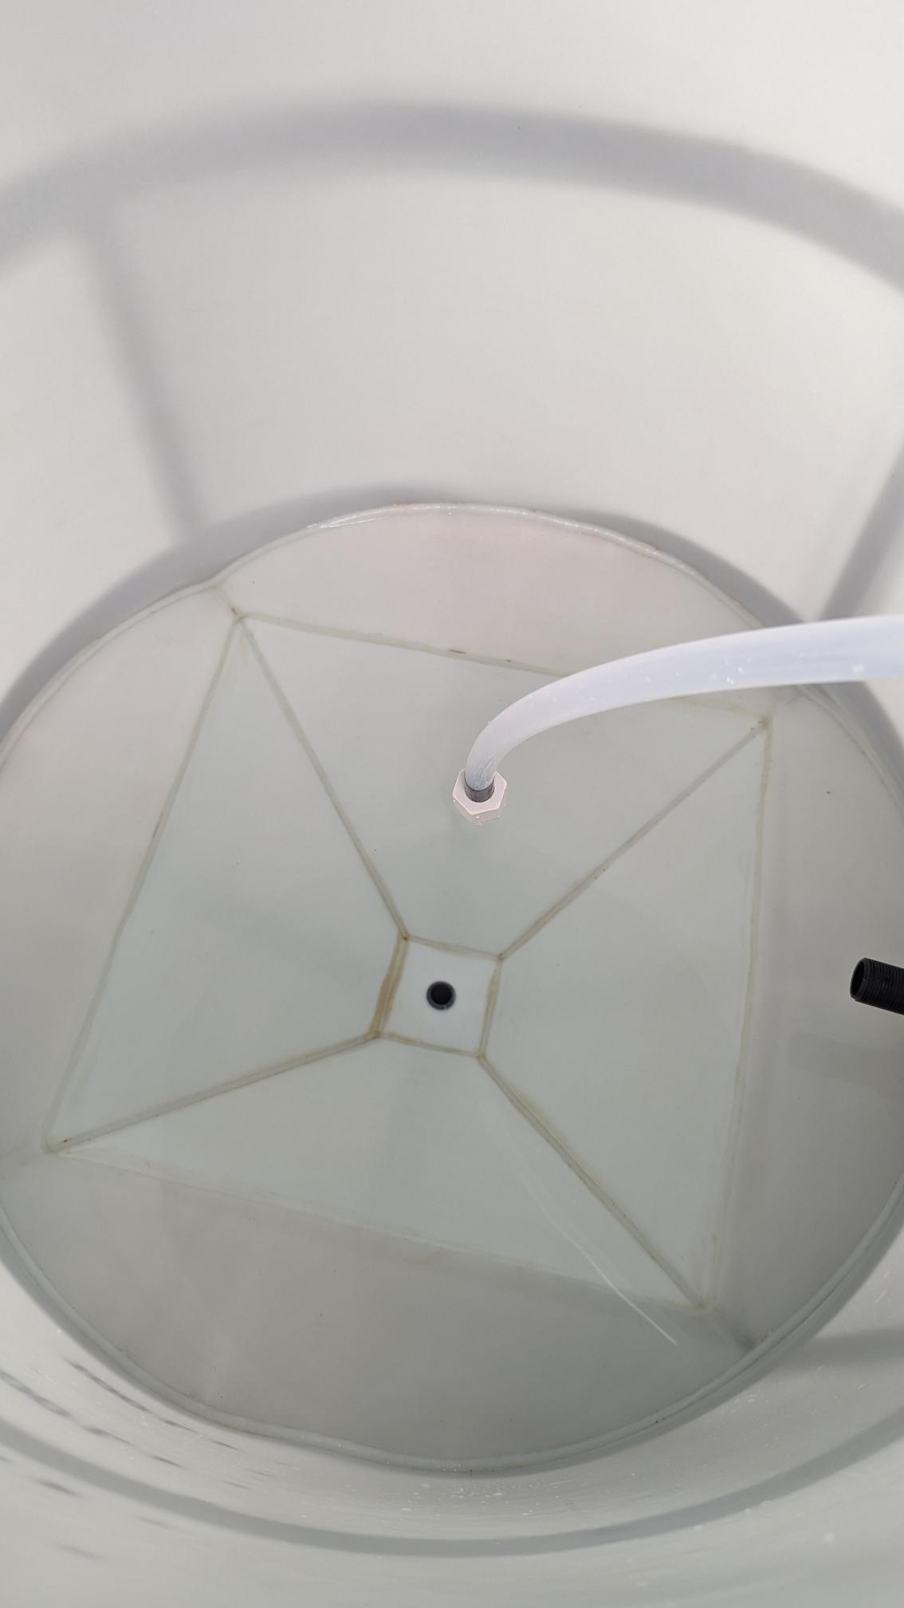
Sample Photos
315K Reject
132K Permeate
Both M250 reject and permeate are clear, no precipitation is observed.

Slide 87
Summary
Recovery by
Gravimetric Measurement: 70.3%
Target Reject TDS : 330K
Assumption: All Mg 2+ and Ca 2+ precipitates out in the feed water
Feed
TDS: 30K
SW30-2540
Reject TDS: 95K
Permeate TDS: 132
M250-4040
Recovery from
Gravimetric Measurement: 73.0%
Permeate TDS : 65K
M250 Permeate Stream (Stream 1) Treatment:
Fluoride Removal
Pre-treatment:
30% Ca(OH)2 Dosage: 9965 mg/L
TDS: 63K
SW30-2540:
Reject TDS: 89K / 95K (SYN)
Permeate TDS: 593
M150-2540
Reject TDS: 181K
Permeate TDS: 95K
M250 Permeate TDS : 65K
M250-4040
Reject TDS: 315K
Permeate TDS: 132K
Recovery by
Gravimetric Measurement:
36.6%
Recovery by
Gravimetric Measurement:
47.3%
Recovery by
Gravimetric Measurement:
42.7%

Slide 88
Plan 3: Pre-Treatment before CFRO

Slide 89
Objectives
Conduct pre-treatment on VE3 feed and determine the maximum recovery using Anti-scalant projection tools.
Pre-treatment:
Ca(OH)2 Dosage
for Fluoride Removal
Feed
TDS: 30K
CFRO

Slide 90
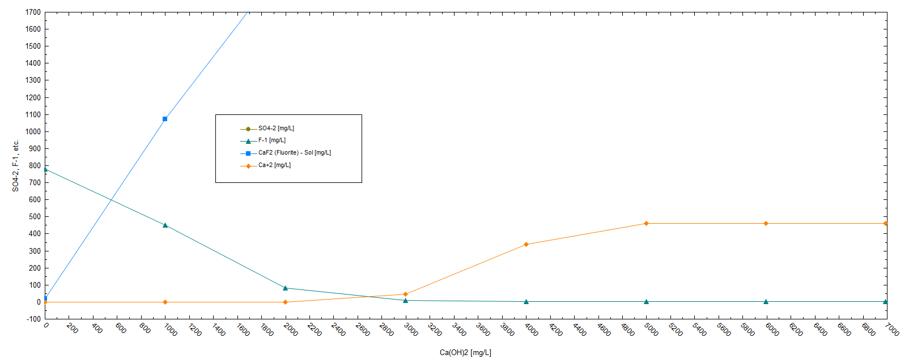
Ca(OH)2 Dosage
Ca(OH)2 dosage is ~4000 mg/L to reduce fluoride to ~4 mg/L.

Slide 91
OLi Projections
Case | Ca(OH)2 Dosage (mg/L) | [Ca 2+] (mg/L) | [Mg 2+] | [Si] (mg/L) | [F -] (mg/L) | [SO4 2-] | Final pH | TDS | Other PPT
Initial | - | 0.0173 | 0.0322 | 4.68 | 779 | 9036 | 9.5 | 30975 | -
1 | 1000 | 0.0585 | 0.176 | 0.044 | 442 | 8748 | 11.71 | 29800 | Mg3Si2O5(OH)4 CaCO3 Mg(OH)2
2 | 2000 | 1.48 | 0.0146 | 0.195 | 81.6 | 8477 | 12.27 | 28850 | Mg3Si2O5(OH)4 CaCO3 Mg(OH)2
3 | 3000 | 72.2 | 0.0524 | 0.409 | 9.97 | 8177 | 12.51 | 27886 | Mg3Si2O5(OH)4 CaCO3 Mg(OH)2
4 | 4000 | 538 | 0.0315 | 0.645 | 4.03 | 7658 | 12.65 | 27944 | Mg3Si2O5(OH)4 CaCO3 Mg(OH)2
Increasing the Ca(OH)2 dosage from 1000 mg/L to 4000 mg/L significantly decreases the [F -] to ~4 mg/L according to the OLi projection.
However, residual [Ca2+] increases to ~538 mg/L.
Case 1 to 4 will be tested to verify this projection.

Slide 92
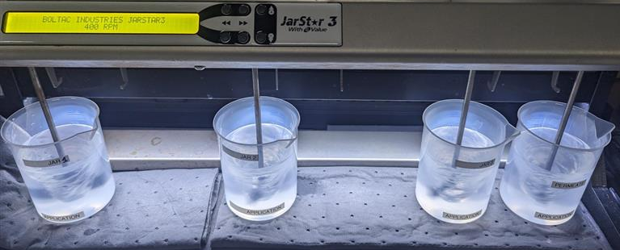
Test Method
Prepare synthetic feed according to the table below:
Conduct jar test according to the table below:
Stir the solution mixture at 400RPM for the first five minutes.
Stir the solution mixture at 40RPM for 30 minutes.
Filter and collect the filtrate, adjust the pH to 6 using 10% HCl if filtrate pH value is > 9.
Send the filtrate for water analysis.
Salts | Mass of Salts required for 1L (mg) | Volume of Feed (L) | Mass of Salts required (mg)
CaCl2 | 27.69 | 3 | 83.07
MgCl2 | 442.67 | 3 | 1328.01
(NH4)2SO4 | 561.1 | 3 | 1683.3
NaHCO3 | 965.12 | 3 | 2895.36
NaF | 2327.26 | 3 | 6981.78
Na2SiO3 | 20.32 | 3 | 60.96
NaNO3 | 438.65 | 3 | 1315.95
Na2SO4 | 12757.72 | 3 | 38273.16
NaCl | 13822.81 | 3 | 41468.43
Jar Test Set-Up
Jar | Feed Volume (mL) | 30% Ca(OH)2 Dosage (mg/L)
0 (Control) | 300 | 0
1 | 300 | 1000 (1mL)
2 | 300 | 2000 (2mL)
3 | 300 | 3000 (3mL)
4 | 300 | 4000 (4mL)

Slide 93
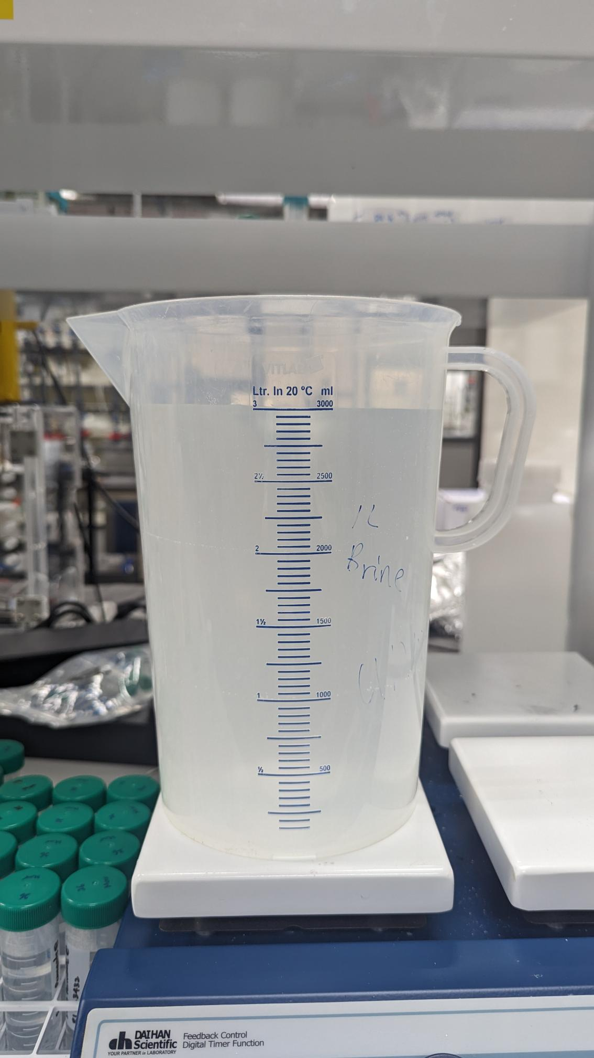
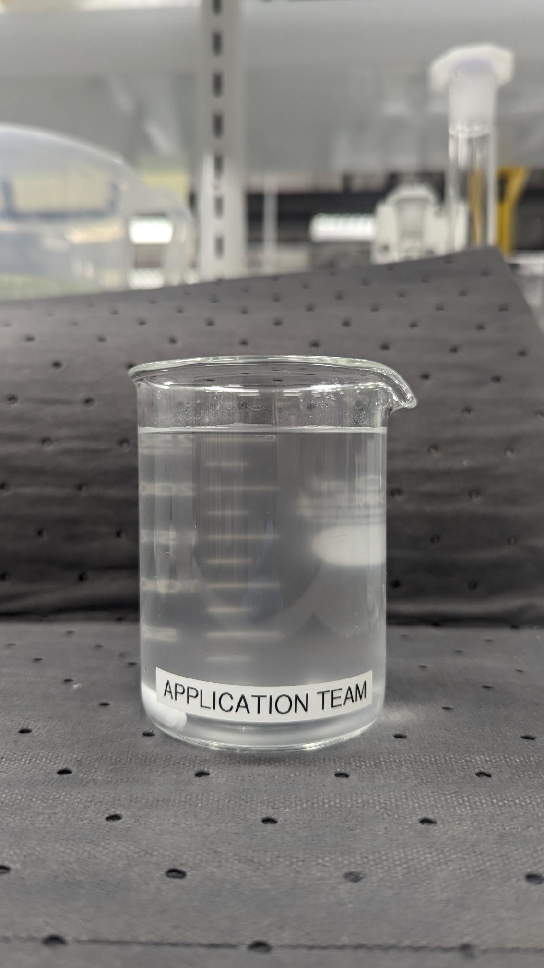

Synthetic Feed Water Analysis Results
Parameters | Units | VE3 Feed | Jar 0 (Control)
Ca(OH)2 Dosage | mg/L | - | -
Feed pH | - | - | 8.25
Final pH | - | - | 8.24
Hydroxide, OH Alkalinity | CaCO₃ mg/l | - | <2
Carbonate Alkalinity, CO3 / P-Alkalinity | CaCO₃ mg/l | - | <2
Bicarbonate Alkalinity, HCO3 / M-Alkalinity | CaCO₃ mg/l | - | 600
Total Alkalinity | CaCO₃ mg/l | 576 | 600
Fluoride as F | mg/L | 1053 | 823
Chloride as Cl |  | 8733 | 8846
Sulphate as SO₄ | mg/L | 9036 | 9282
Nitrate as NO₃ | mg/L | 320 | 646
Magnesium as Mg | mg/L | 113 | <0.1
Calcium as Ca | mg/L | 10 | <0.1
Silica SiO2 | mg/L | 10 | 9.96
Sodium as Na | mg/L | 11168 | 12190
TDS (Gravimetry) | mg/L | 31295 | 29960
Synthetic Feed
(Before Filtration)
Synthetic Feed
(After Filtration)
NaMgF3 PPT were formed.
[Mg 2+] and [Ca 2+] decrease to <0.1 mg/L and [F -] decreases to 823 mg/L.

Slide 94

Observations
Before Ca Dosage
After Ca Dosage

Slide 95
Water Analysis Results
Jar | Feed Volume (mL) | Initial pH | Final pH (After Reaction) | After Filtration | 10% HCl Dosage (mL) | pH after adjustment
0 (Control) | 300 | 8.25 | 8.25 | 8.39 | - | -
1 | 300 | 8.25 | 11.35 | 11.35 | 3.1 | 5.87
2 | 300 | 8.25 | 12.22 | 12.26 | 4.1 | 6.04
3 | 300 | 8.25 | 12.45 | 12.56 | 5.3 | 6.02
4 | 300 | 8.25 | 12.6 | 12.72 | 6.5 | 5.61
Parameters | Units | VE3 Feed | Jar 0 (Control) | Jar 1 | Jar 2 | Jar 3 | Jar 4
Ca(OH)2 Dosage | mg/L | - | - | 1000 | 2000 | 3000 | 4000
Feed pH | - | - | 8.25 | 8.25 | 8.25 | 8.25 | 8.25
Final pH | - | - | 8.24 | 6.22 | 6.25 | 6.19 | 5.82
Hydroxide, OH Alkalinity | CaCO₃ mg/l | - | <2 | <2 | <2 | <2 | <2
Carbonate Alkalinity, CO3/ P-Alkalinity | CaCO₃ mg/l | - | <2 | <2 | <2 | <2 | <2
Bicarbonate Alkalinity, HCO3/ M-Alkalinity | CaCO₃ mg/l | - | 600 | 110 | 330 | 125 | 46
Total Alkalinity | CaCO₃ mg/l | 576 | 600 | 110 | 330 | 125 | 46
Fluoride as F | mg/L | 771 | 823 | 469 | 278 | 107 | 37
Chloride as Cl |  | 8733 | 8846 | 9659 | 9864 | 10582 | 10563
Sulphate as SO₄ | mg/L | 9036 | 9282 | 9103 | 8970 | 9052 | 8752
Nitrate as NO₃ | mg/L | 320 | 646 | 641 | 639 | 641 | 633
Magnesium as Mg | mg/L | <0.1 | <0.1 | <0.1 | <0.1 | <0.1 | <0.1
Calcium as Ca | mg/L | <0.1 | <0.1 | <0.1 | <0.1 | 11.9 | 111
Silica SiO2 | mg/L | 10 | 9.96 | 12.82 | 5.63 | 3.10 | 2.36
Sodium as Na | mg/L | 11168 | 12190 | 11710 | 10310 | 9988 | 10090
TDS (Gravimetry) | mg/L | 31295 | 29960 | 30360 | 30020 | 30320 | 30340

Slide 96

OLi Projection for Jar 1 (1000 mg/L Dosage)
Parameters | Units | Jar 1
Ca(OH)2 Dosage | mg/L | 1000
Feed pH | - | 8.25
Final pH | - | 6.22
Hydroxide, OH Alkalinity | CaCO₃ mg/l | <2
Carbonate Alkalinity, CO3/ P-Alkalinity | CaCO₃ mg/l | <2
Bicarbonate Alkalinity, HCO3/ M-Alkalinity | CaCO₃ mg/l | 110
Total Alkalinity | CaCO₃ mg/l | 110
Fluoride as F | mg/L | 469
Chloride as Cl |  | 9659
Sulphate as SO₄ | mg/L | 9103
Nitrate as NO₃ | mg/L | 641
Magnesium as Mg | mg/L | <0.1
Calcium as Ca | mg/L | <0.1
Silica SiO2 | mg/L | 12.82
Sodium as Na | mg/L | 11710
TDS (Gravimetry) | mg/L | 30360
Kogarkoite PPT when TDS >= 180K mg/L

Slide 97

OLi Projection for Jar 2 (2000 mg/L Dosage)
Parameters | Units | Jar 2
Ca(OH)2 Dosage | mg/L | 2000
Feed pH | - | 8.25
Final pH | - | 6.25
Hydroxide, OH Alkalinity | CaCO₃ mg/l | <2
Carbonate Alkalinity, CO3/ P-Alkalinity | CaCO₃ mg/l | <2
Bicarbonate Alkalinity, HCO3/ M-Alkalinity | CaCO₃ mg/l | 330
Total Alkalinity | CaCO₃ mg/l | 330
Fluoride as F | mg/L | 278
Chloride as Cl |  | 9864
Sulphate as SO₄ | mg/L | 8970
Nitrate as NO₃ | mg/L | 639
Magnesium as Mg | mg/L | <0.1
Calcium as Ca | mg/L | <0.1
Silica SiO2 | mg/L | 5.63
Sodium as Na | mg/L | 10310
TDS (Gravimetry) | mg/L | 30020
Kogarkoite PPT when TDS >= 200K mg/L

Slide 98

OLi Projection for Jar 3 (3000 mg/L Dosage)
Parameters | Units | Jar 3
Ca(OH)2 Dosage | mg/L | 3000
Feed pH | - | 8.25
Final pH | - | 6.19
Hydroxide, OH Alkalinity | CaCO₃ mg/l | <2
Carbonate Alkalinity, CO3/ P-Alkalinity | CaCO₃ mg/l | <2
Bicarbonate Alkalinity, HCO3/ M-Alkalinity | CaCO₃ mg/l | 125
Total Alkalinity | CaCO₃ mg/l | 125
Fluoride as F | mg/L | 107
Chloride as Cl |  | 10582
Sulphate as SO₄ | mg/L | 9052
Nitrate as NO₃ | mg/L | 641
Magnesium as Mg | mg/L | <0.1
Calcium as Ca | mg/L | 11.9
Silica SiO2 | mg/L | 3.10
Sodium as Na | mg/L | 9988
TDS (Gravimetry) | mg/L | 30320
Kogarkoite PPT when TDS >= 258K mg/L

Slide 99


Maximum Recovery according to Anti-scalant Projection: Jar 3

Slide 100

OLi Projection for Jar 4 (4000 mg/L Dosage)
Parameters | Units | Jar 4
Ca(OH)2 Dosage | mg/L | 4000
Feed pH | - | 8.25
Final pH | - | 5.82
Hydroxide, OH Alkalinity | CaCO₃ mg/l | <2
Carbonate Alkalinity, CO3/ P-Alkalinity | CaCO₃ mg/l | <2
Bicarbonate Alkalinity, HCO3/ M-Alkalinity | CaCO₃ mg/l | 46
Total Alkalinity | CaCO₃ mg/l | 46
Fluoride as F | mg/L | 37
Chloride as Cl | mg/L | 10563
Sulphate as SO₄ | mg/L | 8752
Nitrate as NO₃ | mg/L | 633
Magnesium as Mg | mg/L | <0.1
Calcium as Ca | mg/L | 111
Silica SiO2 | mg/L | 2.36
Sodium as Na | mg/L | 10090
TDS (Gravimetry) | mg/L | 30340
No Kogarkoite PPT when TDS is up to 370K mg/L.

Slide 101


Maximum Recovery according to Anti-scalant Projection: Jar 4

Slide 102
Results and Discussions
Jar | [F -] (mg/L) | Residual [Ca 2+] (mg/L) | 30% Ca(OH)2 Dosage (mg/L) | Maximum TDS without Kogarkoite PPT (mg/L) | Maximum Reject TDS according to Anti-scalant projection (mg/L)
1 | 469 | <0.1 | 1000 | 180K | -
2 | 278 | <0.1 | 2000 | 200K | -
3 | 107 | 11.9 | 3000 | 258K | 311K
4 | 37 | 111 | 4000 | 370K | 304K
30% Ca(OH)2 dosage should be >= 3000 mg/L to achieve target reject TDS (210-250K mg/L).
When 3000 mg/L 30% Ca(OH)2 is dosed, maximum TDS without Kogarkoite PPT is ~258K mg/L according to OLi projection.
When 4000 mg/L 30% Ca(OH)2 is dosed, maximum TDS without Kogarkoite PPT is ~304K mg/L according to OLi and anti-scalant tool projections.

Slide 103
Summary: Plan 1
Assumption: All Mg 2+ and Ca 2+ precipitates out in the feed water
Verifying OLI Projection Max TDS without PPT: 160K
RO + CFRO Trial
Feed
TDS: 25K
SW30-2540
Reject TDS: 95K (~56L)
Permeate TDS: 132
M150-2540
Reject TDS: 180K (~19L)
Permeate TDS: 60K (~37L)
Recovery from
Gravimetric Measurement: 72.2%
Recovery by
Gravimetric Measurement: 48.3%
Recovery by Volume:
66.1%
M150 reject near saturation point, not feasible to further treat with M250.

Slide 104
Summary: Plan 2
Recovery by
Gravimetric Measurement: 70.3%
Target Reject TDS : 330K
Assumption: All Mg 2+ and Ca 2+ precipitates out in the feed water
Feed
TDS: 30K
SW30-2540
Reject TDS: 95K
Permeate TDS: 132
M250-4040
Recovery from
Gravimetric Measurement: 73.0%
Permeate TDS : 65K
M250 Permeate Stream (Stream 1) Treatment:
Fluoride Removal
Pre-treatment:
30% Ca(OH)2 Dosage: 9965 mg/L
TDS: 63K
SW30-2540:
Reject TDS: 89K / 95K (SYN)
Permeate TDS: 593
M150-2540
Reject TDS: 181K
Permeate TDS: 95K
M250 Permeate TDS : 65K
M250-4040
Reject TDS: 315K
Permeate TDS: 132K
Recovery by
Gravimetric Measurement:
36.6%
Recovery by
Gravimetric Measurement:
47.3%
Recovery by
Gravimetric Measurement:
42.7%

Slide 105
Summary: Plan 3
Conduct Fluoride removal pre-treatment for VE3 before ROi.
Pre-treatment:
30% Ca(OH)2 Dosage: 3K-4K mg/L
for Fluoride Removal
TDS: 30K
CFRO
Final Reject TDS (Projections): 250 – 300K
Feed
TDS: 30K

Slide 106
Comparisons
Membrane Model | Recovery by Gravimetry TDS (%)
 | Plan 1 | Plan 2 | Plan 3
SW30 | 72.2 | 73.0
M150 | 48.3 (180K)
M250 |  | 70.3 (>300K) | 250 – 300K (Projection Values)
Stream 1
SW30 |  | 36.6
M150 |  | 47.3
M250 |  | 42.7 (>300K)
Chemical Dosage
Ca(OH)2 Dosage (mg/L) |  | 10K | 3 – 4K
Ca(OH)2 Dosage Feed Volume: 1000L (g) |  | 2,251 | 3,000 – 4,000
Plan 3
Chemical Dosage
Plan 2
Chemical Dosage
Both plan 2 and 3 can achieve target final reject TDS ~210 – 250 mg/L.
Plan 2 permeate stream requires separate train treatment.
Plan 3 only requires a single train but higher chemical dosage.

